Slide 1
Water in the Air
Week 4

Slide 2
Journal Entry 9/17
Why do water drops form on a cold glass of water?

Slide 3
Weather
Weather is the condition of the atmosphere at a certain time and place.

Slide 4
Water Cycle
We are going to work on filling in the water cycle diagram.

Slide 6
Water Cycle
Water Cycle is the continuous movement of water from sources on Earth’s surface into the air, onto and over land, into the ground, and back to the surface.

Slide 7
Condensation
Condensation occurs when water vapor cools and changes from a gas to a liquid.
Clouds form by this process.
Condensation occurs when saturated air cools.

Slide 8
Precipitation
Precipitation occurs when rain, snow, sleet, or hail falls from the clouds onto Earth’s surface.

Slide 9
Runoff
Runoff is water, usually from precipitation, that flows across land and collects in rivers, streams, and eventually the ocean.

Slide 10
Evaporation
Evaporation occurs when liquid water changes into water vapor, which is a gas.

Slide 11
Water Cycle Bracelet
Now we are going to develop a model of the water cycle.

Slide 12
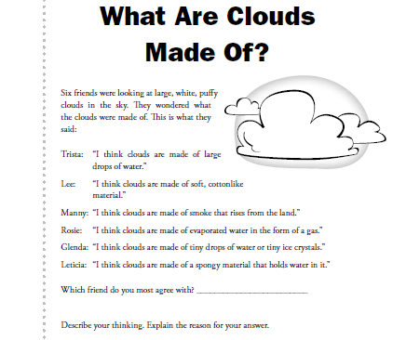

Slide 13
Clouds
A cloud is a collection of millions of tiny water droplets or ice crystals.
Clouds form as warm air rises and cools.
The air cools and becomes saturated so the water vapor changes from a gas to a liquid.
Clouds are classified by their form and height.

Slide 14
Cumulus Clouds
Puffy, white clouds that tend to have flat bottoms.
Form when warm air rises.
Generally indicate fair weather, but when they get larger they produce thunderstorms.

Slide 15
Cumulonimbus
The type of cumulus cloud that produces thunderstorms.
Clouds that have names that include –nimbus or nimbo- are likely to produce precipitation.

Slide 16
Stratus Clouds
Form in layers.
Cover large areas of the sky and often block the sun.
Caused by a gentle lifting of a large body of air into the atmosphere.
Fog is a stratus cloud that has formed near the ground.

Slide 17
Nimbostratus clouds
Dark stratus clouds that usually produce light to heavy, continuous rain.

Slide 18
Cirrus Clouds
Thin, feathery, white clouds found at high altitudes.
Form when the wind is strong.

Slide 19
Clouds
Clouds can also be classified by the altitude at which they form.
The prefix cirro- is used to describe clouds that form at high altitudes.
The prefix alto- is used to describe clouds that form at middle altitudes.

Slide 20
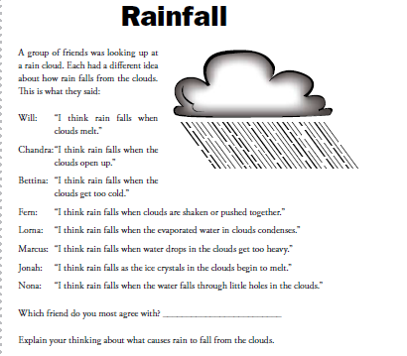

Slide 21
Precipitation
There are four main types of precipitation: rain, snow, sleet, and hail.

Slide 22
Rain
Most common form of precipitation.
A cloud produces rain when the water drops in the cloud become large enough to fall.

Slide 23
Sleet and Snow
Sleet forms when rain falls through a layer of freezing air creating falling ice.
Snow forms when temperatures are so cold that water vapor changes directly to a solid.
Snow can fall as a single crystal or join to create snowflakes.

Slide 24
Hail
Balls or lumps of ice that fall from clouds.
When updrafts of air in the clouds carry raindrops high in the clouds, the raindrops freeze and hail forms.

Slide 25
Creative Writing
Write a short story that describes the travels of a water molecule from the moment it evaporates from the sea to the moment it returns to the sea.
Use first person: I, me, my, mine
Write in complete sentences; use quotation marks correctly.
Include the following vocabulary: evaporation, condensation, precipitation, run-off, cloud (or a cloud type).

Slide 26
Water Vapor
Water Vapor is the amount of moisture in the air.
The warmer the air, the more water vapor it can hold.
The cooler the air, the less water vapor it can hold.

Slide 27
Humidity and Relative Humidity
Humidity is the amount of water vapor in the air.
Relative humidity is the amount of water vapor in the air compared with the maximum amount of water vapor that the air can hold at a certain temperature.

Slide 28
Relative Humidity
Saturated air has a relative humidity of 100%
The more water vapor in the air, the higher the relative humidity.
Measured using a psychrometer or hygrometer and a special table.
Paper towel demonstration

Slide 29
Dew Point
The dew point is the temperature at which a gas condenses into a liquid.
Condensation cannot occur until the dew point is reached.

