Slide 1
Adam Smith VS Karl Marx
Adam Smith and Karl Marx the greatest economic analysts the world has ever seen

Slide 2
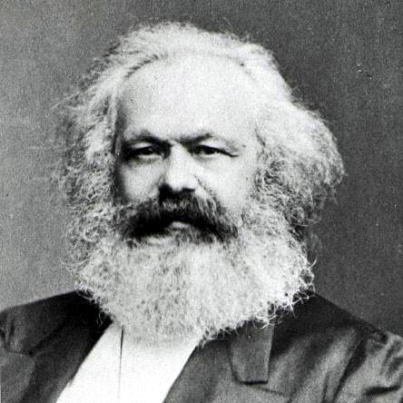
Smith VS Marx
Scottish economist born in 1723
Considered the father of modern day economics
Stated that the workers always look for the best jobs and the best wages
Believed in the liberty of all individuals through a capitalistic approach
Western approach in his thought processing on economics
German economist born in 1818
Considered the father of Communism
Stated a labor-wage war will break down society and lead to the downfall of the economy
Believed in individual freedom
Critic of capitalism and believed that Socialism would replace capitalism.

Slide 3
Smith VS Marx
Advocate of free market
Opinion that each person has the right to pursue happiness and he has to take that in his own hands to advance within the society
Published the principles of Capitalism in his book, Wealth of Nations (1776)
Advocate of small government
Thought free market would make the rich richer and the poor poorer
Opinion that when a person betters himself, he is not improving but endangering the society
Published the basic idea of Communism through his book, Communist Manifesto' (1848), which he co-authored with Frederick Engels
Advocate of larger government

Slide 4
Summary
Adam Smith
Karl Marx
had stated that the workers always look for the best jobs and the best wages.
believed in the liberty of all individuals through a capitalistic approach.
was of the opinion that each person has the right to pursue happiness and he has to take that in his own hands to advance within the society.
was of the opinion that a labor- wage war will break down the society and lead to the downfall of the economic composition.
on the contrary, believed that Socialism will replace capitalism.
was of the opinion, when a person betters himself he is not improving but endangering the society.

