Slide 1
Transforming from the Middle Ages
WHAT IT WAS
Feudal System
Manors
Church is all knowing
Black Death
Focus on the Afterlife
Focus on Group
HOW IT CHANGED
Nobles, middle class, peasants
Trade/money/lending/ banking/insurance
Questioned church/secular view
Celebrate life/Enjoy the Present/ Humanism
Focus on Individual

Slide 2
Renaissance

Slide 3
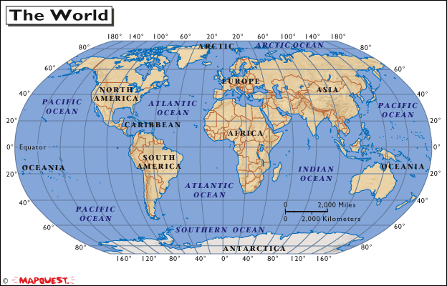

Slide 4
The Renaissance
Renaissance--Means rebirth; a period when Europe experience many cultural changes and saw a rebirth of the ideas and thoughts of the ancient Greeks and Romans. It was a golden age in the arts, literature and sciences.
During the Middle ages, philosophers and writers were concerned with life after death.
Instead of the medieval preoccupation of life after death, a new way of thinking, Humanism, focused on life in the present and emphasized individual achievements.
Ancient knowledge was rediscovered and the Classical period of the Greeks and Romans were glorified.

Slide 5
Why Italy?
Classical Heritage
Return to Greek and Roman ideals
Arts and scholars – inspired by ruins of Rome
1300’s = Latin and Greek manuscripts studies
Urban Centers
Large city-states in northern Italy (Florence, Milan)
Cities – breeding ground for intellectual revolution
Thriving centers of trade and manufacturing
Wealthy Merchant Class
Merchants – wealthiest, most powerful class & dominated politics
Had $ to pursue other interests – Arts/education
Medici Family –
Cosimo de’ Medici – Influenced the ruling council (loans)
Lorenzo de’ Medici – behind the scene dictator

Slide 6
Reasons for the Renaissance
Growth of city-states
Travel and Commerce
Development of the philosophy known as Humanism

Slide 7
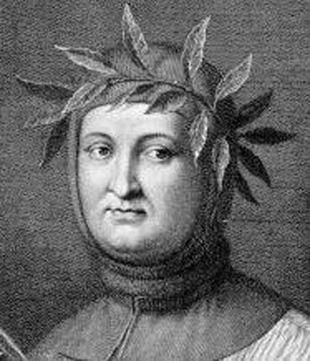
Humanism
Emphasis on the value of
Human beings
Francesco Petrarch
Father of Humanism
-Italian scholar and poet
-Petrarch's sonnets were admired and imitated throughout Europe during the Renaissance and became a model for lyrical poetry

Slide 8
Humanism:
An intellectual movement that stressed the importance of life on earth rather than on the future life in heaven.
Behold Nature with reverence.
What in nature inspires you?
Base religion upon Reason.
What understanding has science brought us?
Treat all people as equals.
No one is born as a superior to anyone else, and we all must obey the same standards of good and bad behavior.
Reality is our lives here on Earth.
Act to reduce suffering and misery, and advance contentment, and happiness.
Exalt the correlation of past, present, and future.
What we do today affects the world of the future. Things done in the past still help us today.
The human mind is limitless.
Each person should try to better themselves as much as possible through gaining an better education.

Slide 9
Patron---a wealthy or influential supporter of a writer or artist; i.e. Medici Family

Slide 10
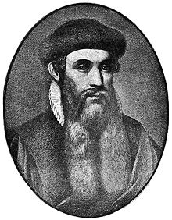
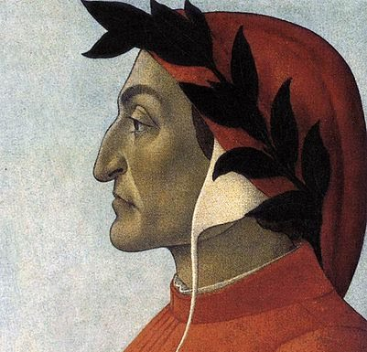
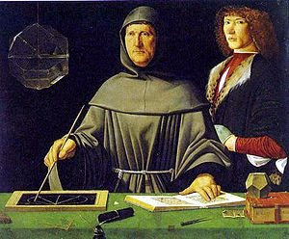
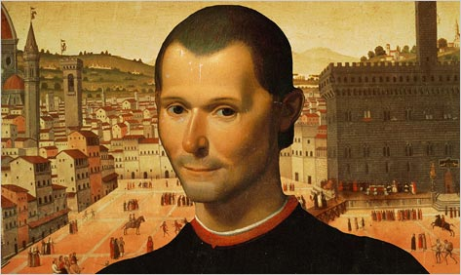
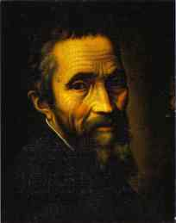
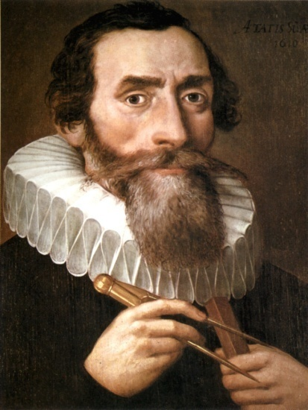
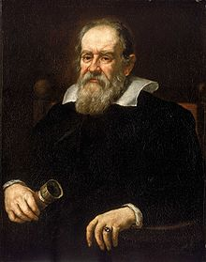
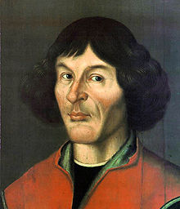
Innovate--To introduce something new; make changes in anything established.
http://www.youtube.com/watch?v=0CRX_mqpzdU

Slide 11
Humanism affected Art
During the Middle Ages, artists were seen as humble servants whose talent and ability were meant to honor God.
This is evident in the work of medieval artists adorning churches and cathedrals.
During the Renaissance, artists were trained intellectuals
They were well versed in the classics and mathematical principles.
The art that they created reflected this newfound perspective.

Slide 12
Renaissance Art
Some of the greatest paintings, sculptures, and architecture in the history of the world.
Greek and Romans styles were used for columns, arches, and domes.
Artists were supported by merchants, popes and princes.
Art was detailed, realistic, and reflected study of human anatomy

Slide 13
Perspective--Method for depicting a 3-D object on a 2-D surface.

Slide 14
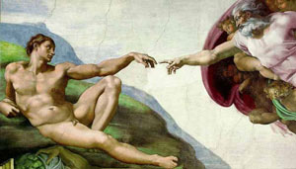
Michelangelo

Slide 15
Leonardo da Vinci

Slide 16
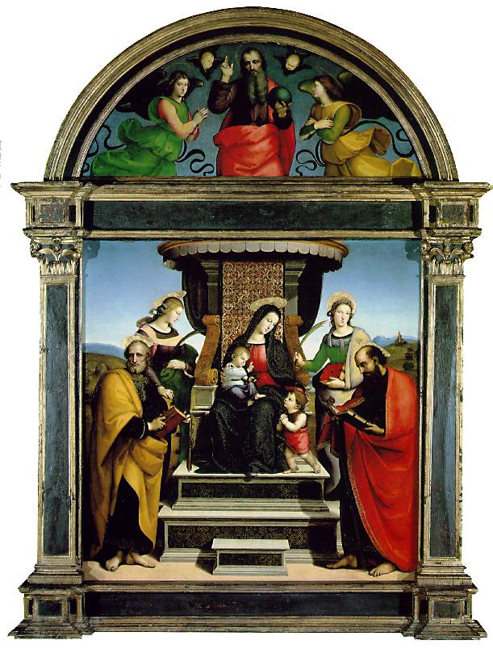
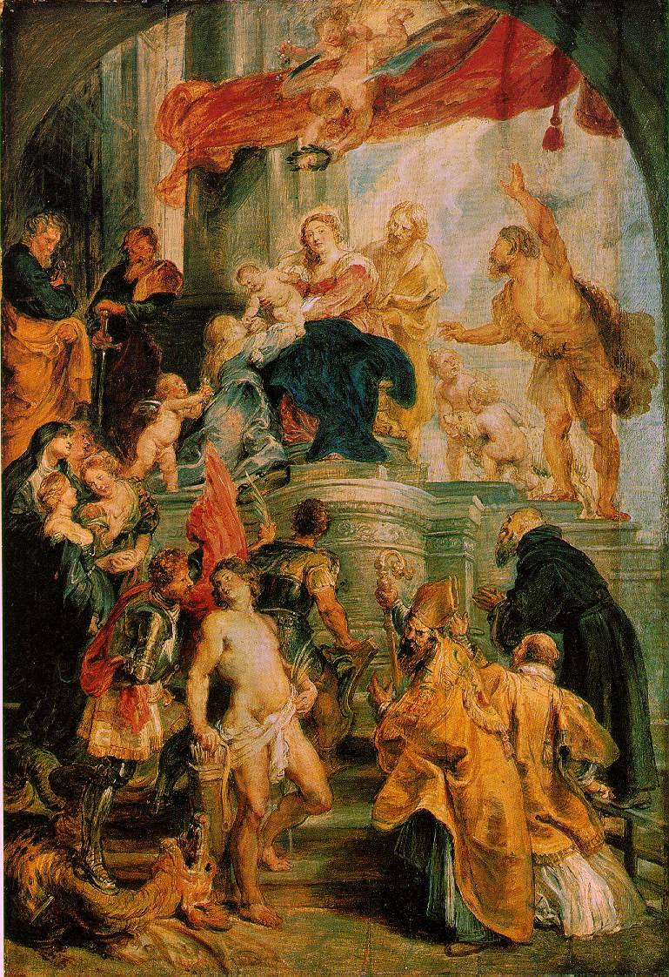
Raphael and Rubens

Slide 17
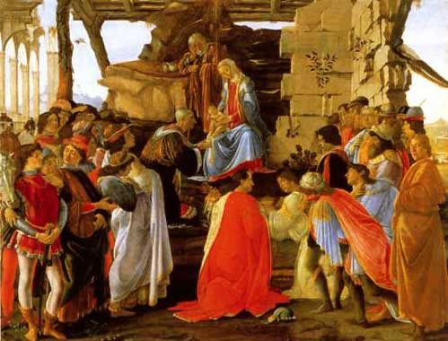
Botticelli

Slide 18
New Outlook/Attitude Classical - Worldly
Patrons of Arts
Church – spent $$$ beautifying Rome
Wealthy families – supported artists
Renaissance Man
Ideal individual strove to master all areas of study
“universal man”
Renaissance Woman
Inspire but not create art

Slide 19
People were still devout Catholics but… concerns were secular (worldly and here/now)
New Outlook/Attitude
Enjoyment of Worldly Pleasures
Middle Ages
-- piety
--looking toward afterlife
Renaissance
--Humanists
--can enjoy life without insulting God

Slide 20
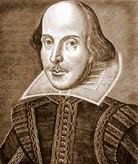
Literary Achievements
Dante Wrote the Divine Comedy
Cervantes wrote Don Quixote
Shakespeare wrote many plays and poetry
Machiavelli wrote The Prince

Slide 21
Science and Technology
Mathematical advances during the Renaissance accelerated exploration of science.
A movement towards scientific inquiry and scientific thought led to innovations and scientific advancement.
“All truths are easy to understand once they are discovered; the point is to discover them.” -Galileo

Slide 22
Science and Technology
Galileo Galilei was an Italian physicist, mathematician, and astronomer. He invented an accurate telescope.
Tycho Brahe was a Danish nobleman known for his accurate and comprehensive astronomical and planetary observations.
Johannes Kepler was a German mathematician and astronomer. He used Brahe’s work to discover the planets move in orbits that are elliptical in shape.
Nicolaus Copernicus was a Polish astronomer. He developed the theory that the sun was the center of the universe, an idea that was considered scandalous and heretical because the prevailing view was that the Earth itself center of the universe.

Slide 23
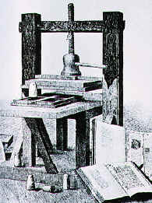
The Printing Press
Invented by Johannes Gutenberg, a German metalworker and inventor.
By 1300 papermaking and print technology had reached Europe from China.
The invention of moveable type led Gutenberg to print the Bible in 1456.
In pairs, discuss the impact of the printing press on Renaissance man and today. Be prepared to explain what you think.

Slide 24
Impact of Printing Press
Books became more accessible
Literacy increased
Ideas spread rapidly

Slide 25
Innovators Project
Pick an Innovator
You may work in pairs or by yourself
You must answer 3 questions from handout (and ONLY these questions)
You MUST cite your sources
You will present using a Google presentation

