Slide 1
The Ottoman Empire
AIM: What was the source of the Ottoman’s power?
Homework: Homework Packet #2
Due Friday

Slide 2
The Ottomans were:
Turkish (capital Istanbul)
Muslim
The largest empire in the world at the time 14th-16th Centuries 1453-1792

Slide 3
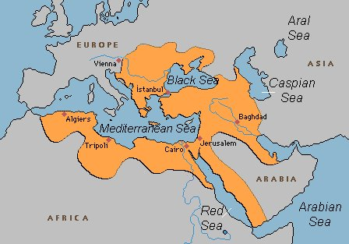
Istanbul (formerly Constantinople)
3 Continents

Slide 4
What was the source of the power of the Ottoman power?
Three (3) Ottoman Strengths:

Slide 5
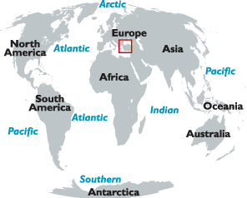
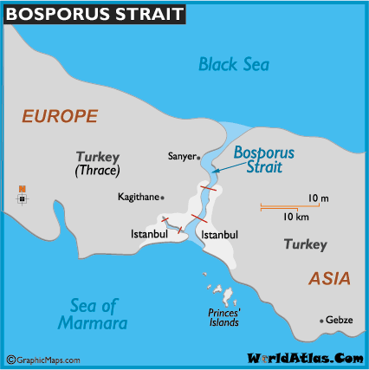
1. Control of Trade
Location on the east/west trade route
Control of the waterways

Slide 6
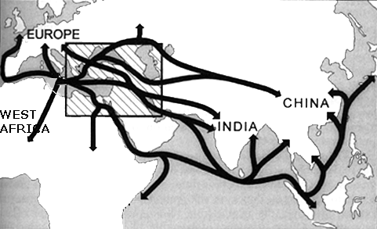

Slide 7
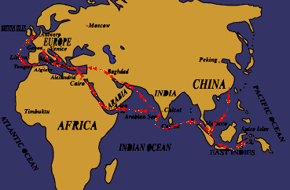

Slide 8
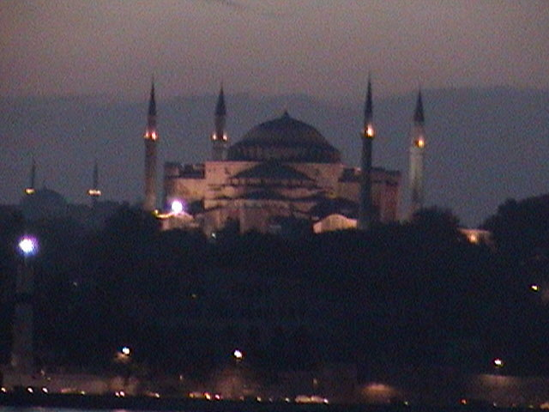
2. Wealth from trade

Slide 9
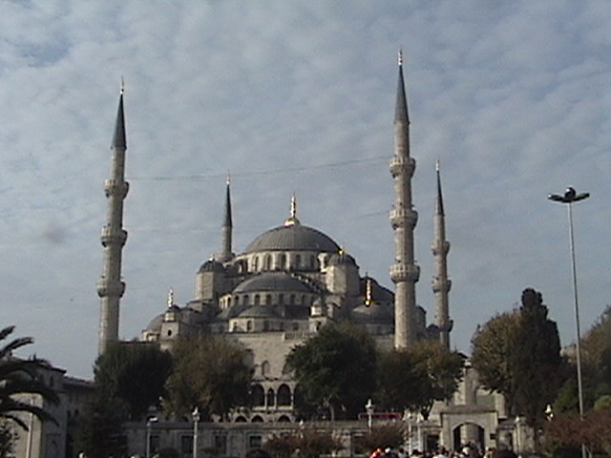
Süleymaniye Mosque
minaret
Call to Prayer

Slide 10
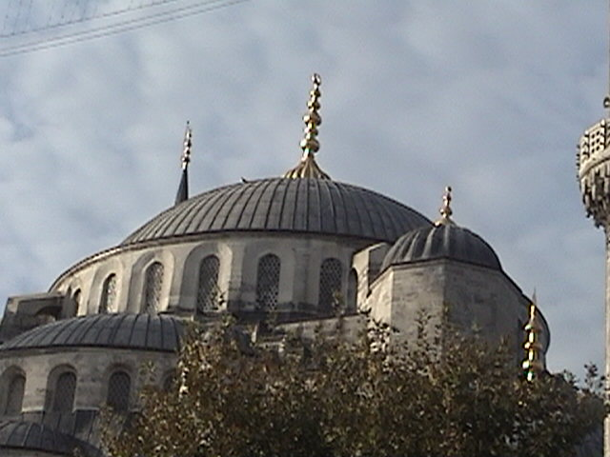
There are around 3000 mosques in Istanbul which 600 of them belong to the Ottoman period.

Slide 11
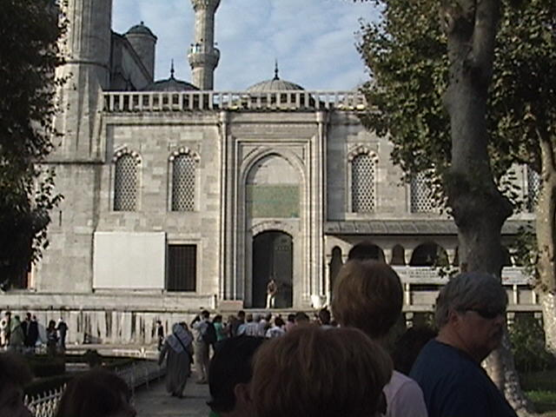

Slide 12
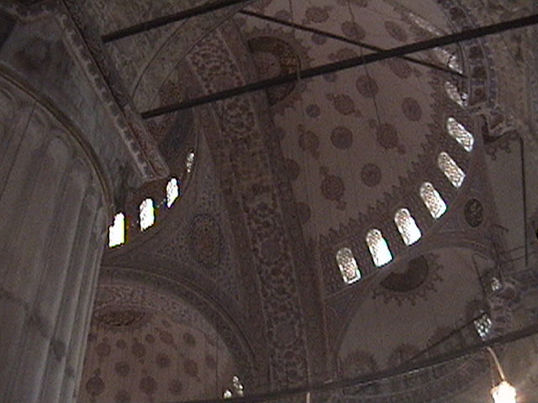

Slide 13
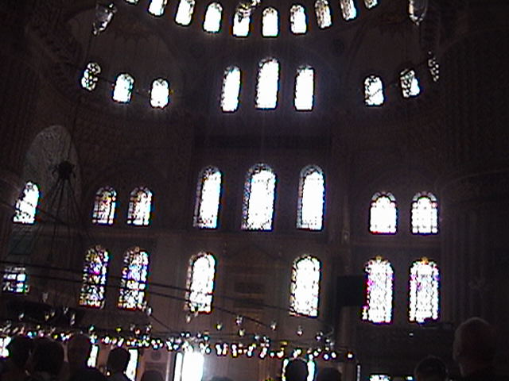

Slide 14
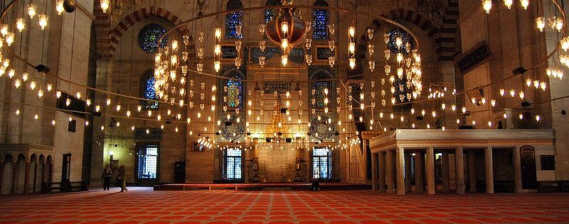

Slide 15
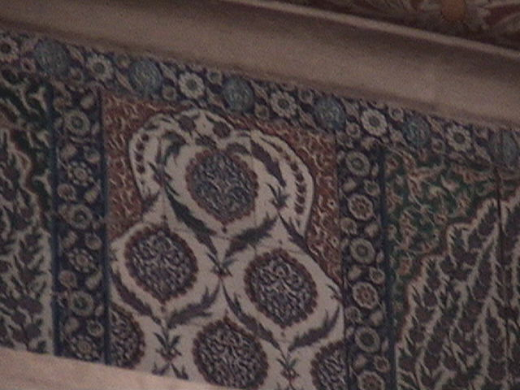
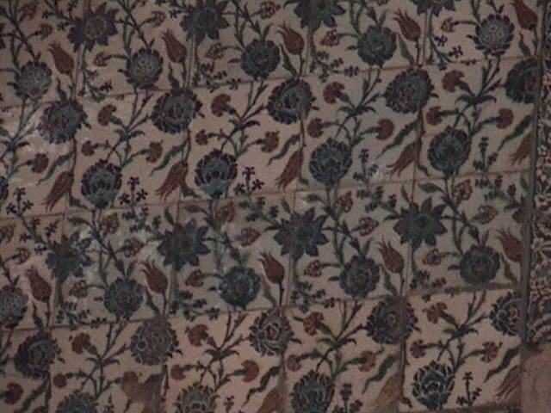
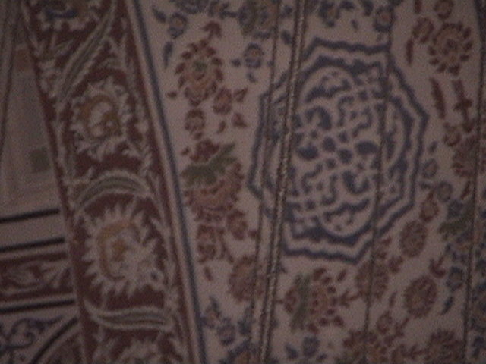
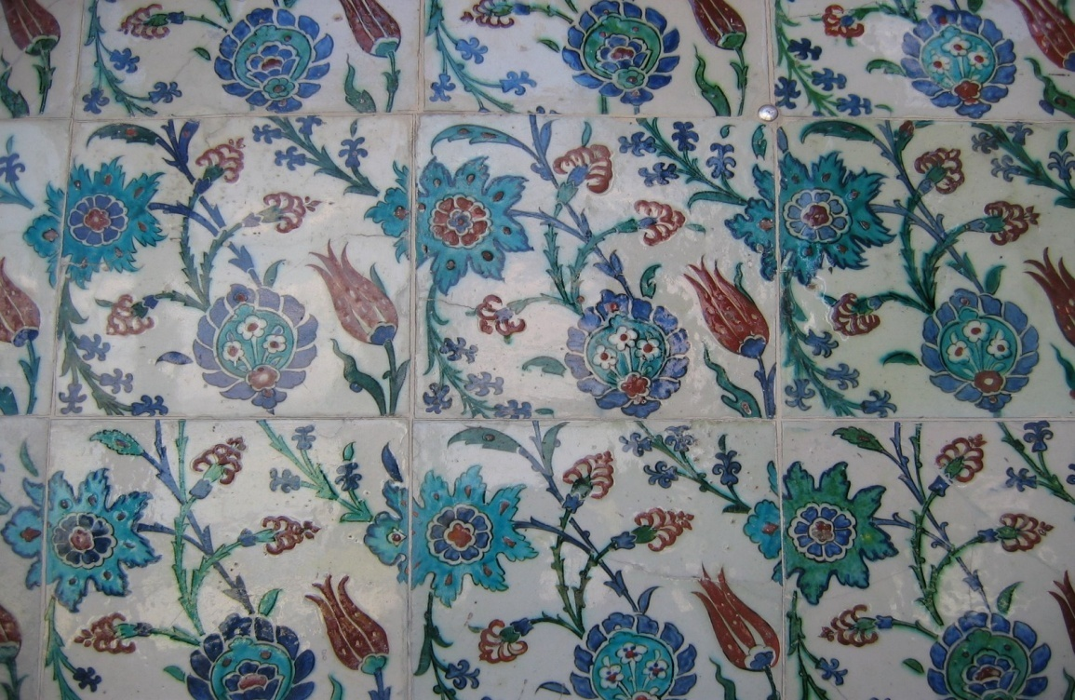
Iznik (Ceramic) Tiles

Slide 16
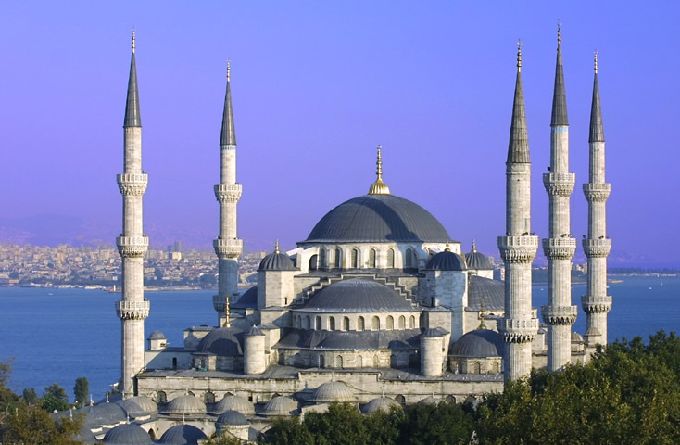
Blue Mosque

Slide 17
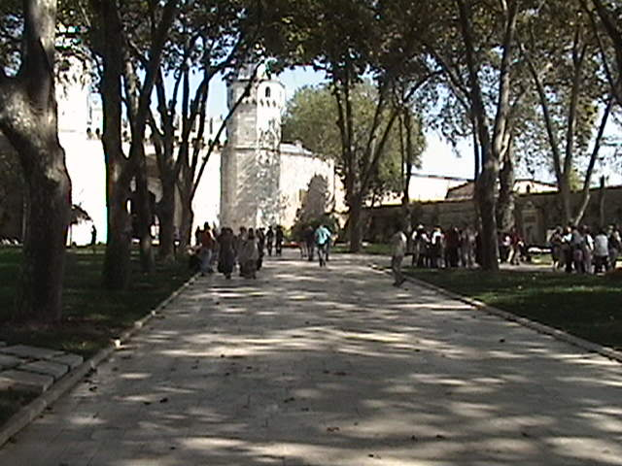

Slide 18
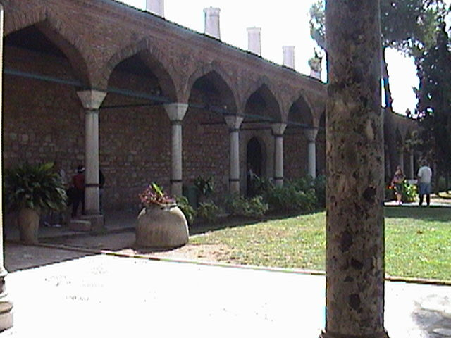

Slide 19
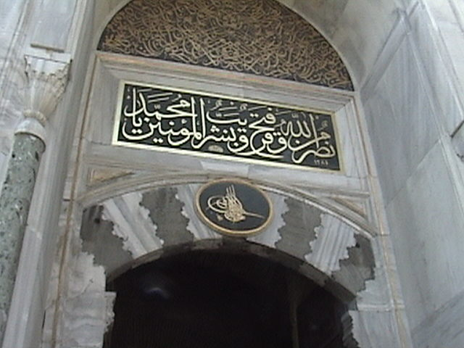

Slide 20
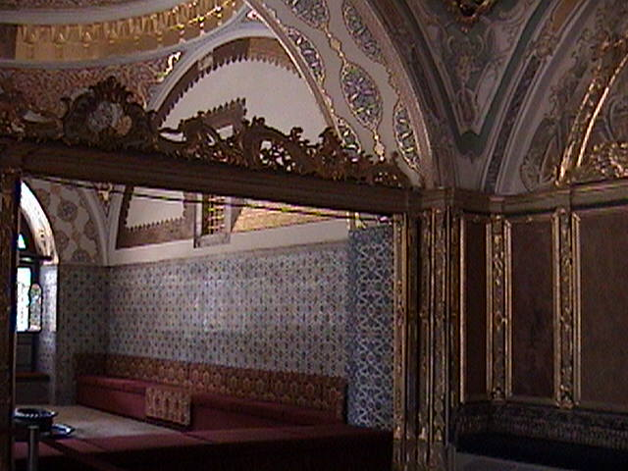

Slide 21
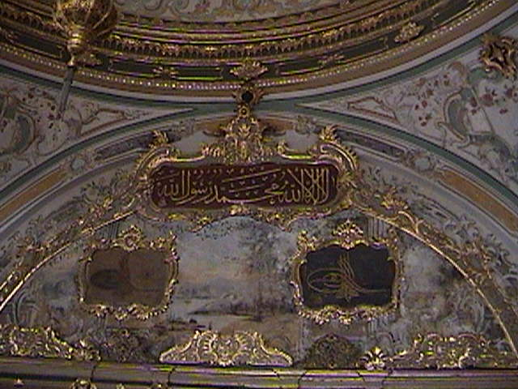

Slide 22
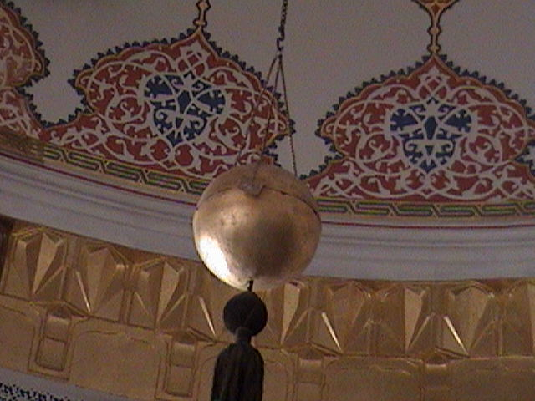

Slide 23
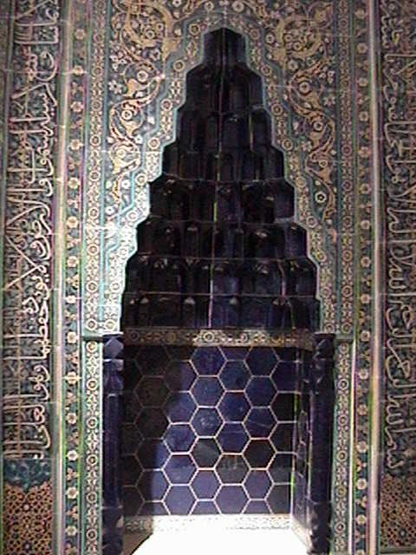
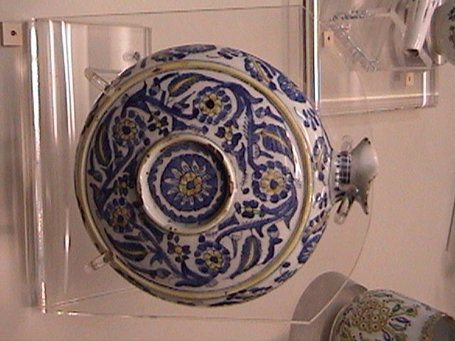

Slide 24
3. Superior Technology (the benefit of cultural diffusion)
Astronomy & Geography
Rejected Aristotle’s Earth Centered Approach
Built Observatories
Medicine & Education
1st Surgical Atlas (Illustrated)
Science
Mechanical Clock
Steam Turbine (Spit)
1st Map of America’s & Antarctica (Piri Reis map)
1st Technical University
Physics/ Motion & Optics

Slide 25
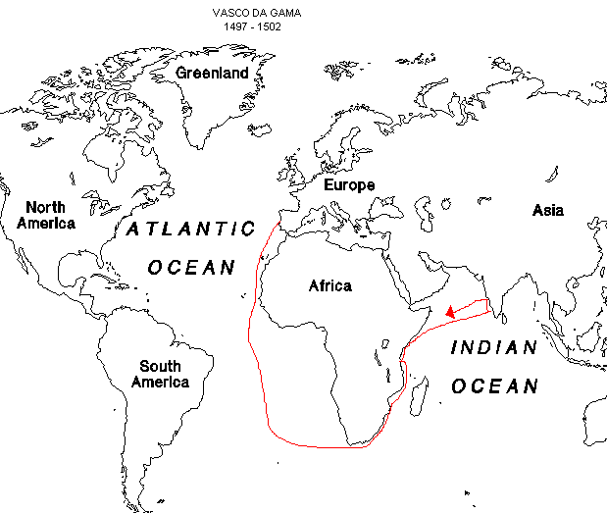
How did the empire end?
The Europeans destroyed their strengths.
How?
Europeans broke this strength by going around Africa and gaining control of trade.

Slide 26
1453 Muslims take over former Byzantine Empire
Change capital city name from Constantinople to Istanbul
Empire Spans 3 Continents (Asia, Africa, Europe)
Control trade East & West (Control Mediterranean Sea trade)
Benefited from Cultural Diffusion & created a unique culture
Ends After WWI – Broken up into separate countries (partitioned) – Some land became Turkey

Slide 27
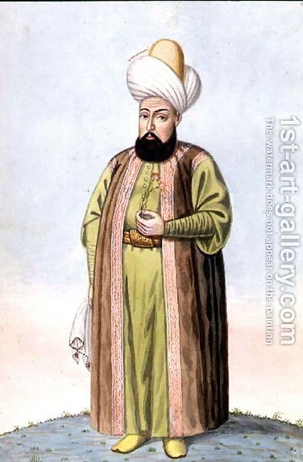
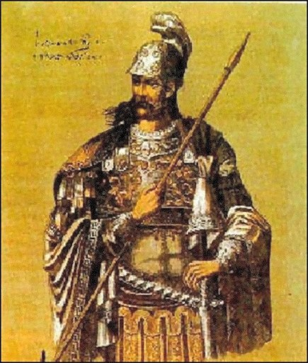
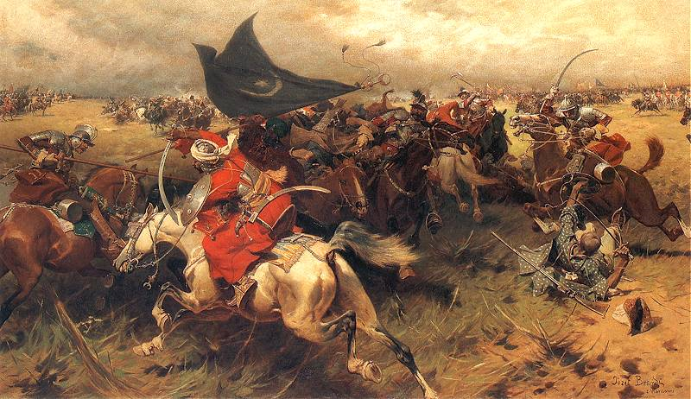
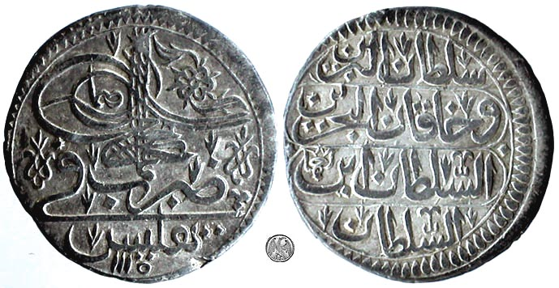
Activity: Ottoman Empire Worksheet
If not completed / Add to Homework Packet
Tomorrow: The Age of Exploration

Slide 28
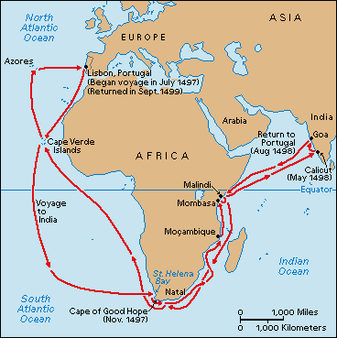
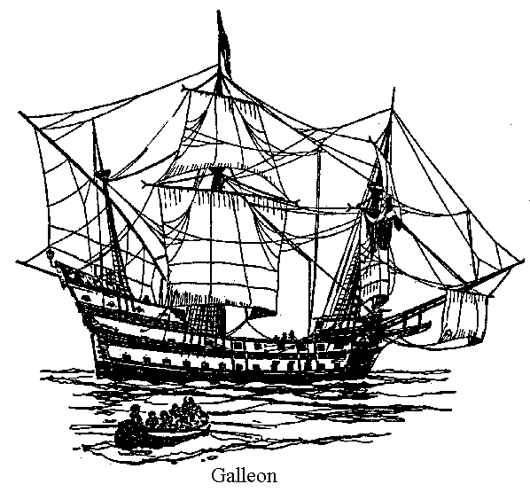
Review:
What was the source of the Ottoman’s power?
Location, Location, Location
Empire Spans 3 Continents (Asia, Africa, Europe)
Control trade East & West (Control Mediterranean Sea trade)
Why did it end?
European exploration, travel, trade to the Americas and around Africa.

