Slide 1
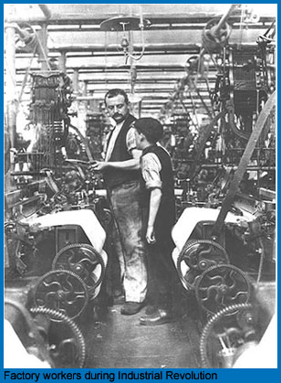
The Industrial Revolution
AIM: What was life like before & during the Industrial Revolution?
Europe c.1740- Early 1900s

Slide 2
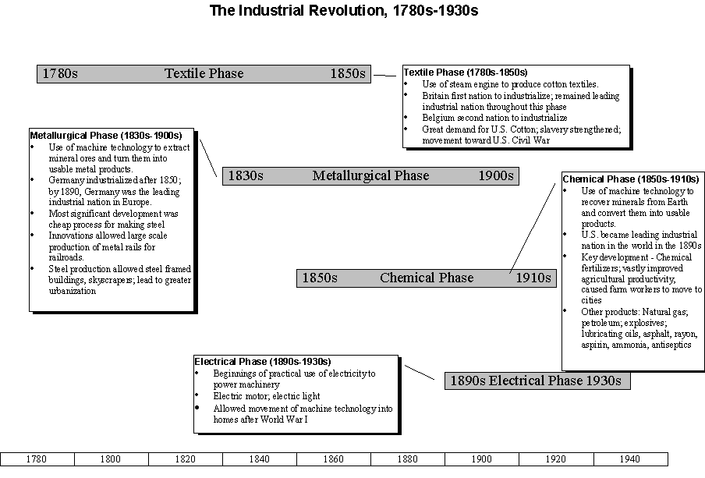
Industrial Revolution

Slide 3
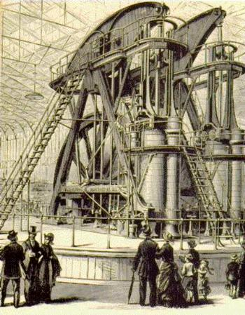
What was the Industrial Revolution?
A shift from home made goods to mass produced factory goods.
Began in Great Britain (England, Wales, Scotland, N. Ireland) in the Middle of the 1700s

Slide 4
Home/Cottage:
Clothes
Pottery
Leather Goods
Cloth
Work was usually done on the 1st Floor of their home.
Whole Family Participated.
Before: People Worked inside Home (Cottage Industry)

Slide 5
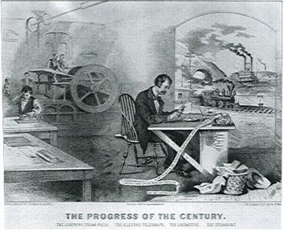
Factories:
Machines operated by people made goods.
Work was usually done at factory.
People lived in crowded buildings.
Men, Women, Children worked in Factory.
During/After: Work in Factories

Slide 6
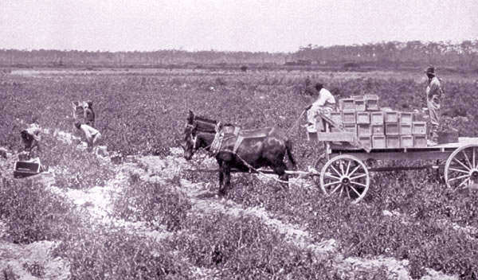
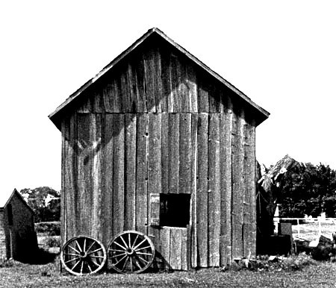
Before: People Lived in Rural Areas (Farms)

Slide 7
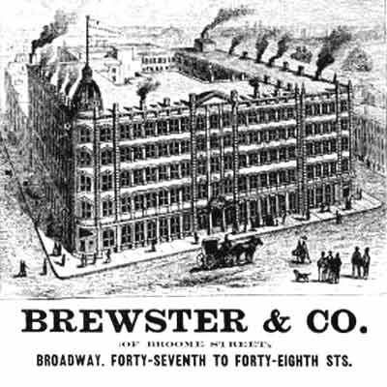
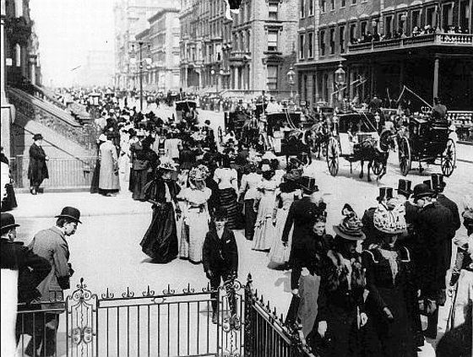
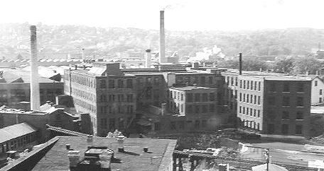
During/ After: People Lived in Cities near Factories for work.

Slide 8
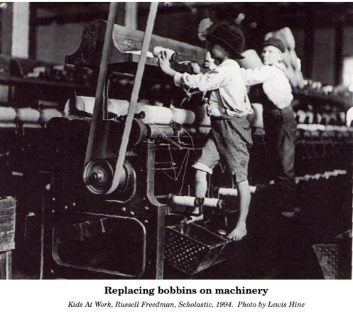
Children Working in Factories

Slide 9
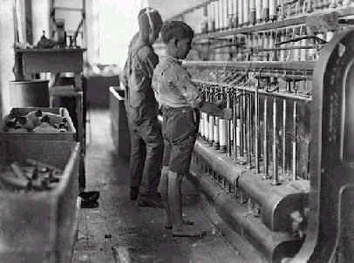
Children Working in Factories

Slide 10
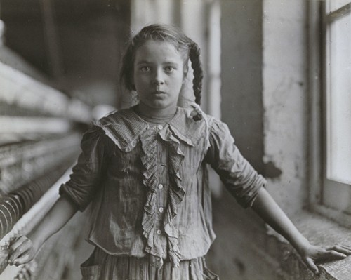
School Age Girl Working in a Factory

Slide 11
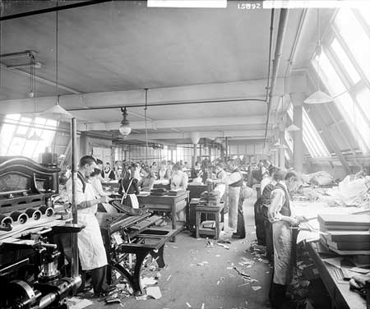
Men & Women Working in Factories

Slide 12
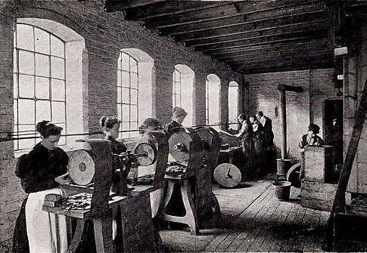
Women & Men Working in Factories

Slide 13
What do machines allow people to do that couldn’t be done by hand?
Factories
Mass Production
More Goods
Consumer Economy
MASS PRODUCTION

Slide 14
What was life like Before & During/After the Industrial Revolution. Describe or Name two (2) for each.
Before:
During /After:
1.
1.
2.
2.
Before & After

Slide 15
Causes of changes during the Industrial Revolution
Fewer farmers produced more food than ever before.
Great Britain had many very wealthy people.
Britain had a growing market at home and in the colonies.
Steam engine was invented.
Machines were built that were powered by water and steam.
Unskilled workers could run the new machines.
European nations wanted to keep their colonies as sources of raw materials.
Cities did not have sewer systems or garbage collection.
Wealthy business owners believed the theory of Social Darwinism.
Working conditions in factories were terrible.

Slide 16
Effects of changes during the Industrial Revolution
Many farm laborers were forced off the land to find work in the cities.
People had capital to invest in building factories.
Factory owners had markets for their products.
Transportation was revolutionized; goods could be moved more rapidly than ever.
Cottage industry system ended and the factory system began.
Even children began working in factories.
Much of Africa, Asia and Latin America did not industrialize.
Disease spread quickly in urban areas.
Wealthy business owners did not have to improve workers conditions.
Labor unions developed to protest and demand reforms.

