Slide 1
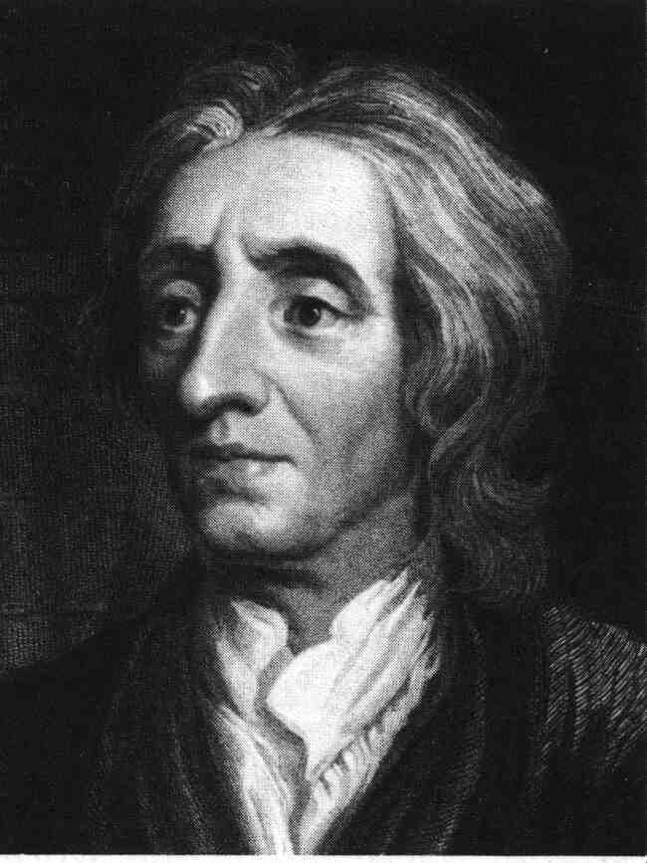
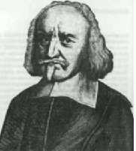
Thomas Hobbes vs. John Locke
AIM: What is the difference between Hobbes and Locke’s view of government?
Two Visions of
Government and Rights
Do Now: How would life in Greenville be different if there was no government?

Slide 2
Social Contract Theory
Imagine two situations:
Government (the state)
No government (the state of nature)
Which would you choose?

Slide 3
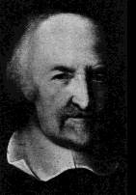
Thomas Hobbes (1588-1679)
Wrote Leviathan
Didn’t believe in Revolutions
Believed in Absolute Monarchy
Life in the state of nature would be “solitary, poor, nasty, brutish, and short”

Slide 4
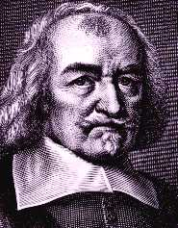
Hobbes’s Social Contract
You would give up
Liberty
To gain
Security

Slide 5
John Locke
Wrote Two Treatises of Government
Believed in Natural Rights that come from nature or God
Those rights include: Life, Liberty (freedom), and Property
Believed in Limited Government that protected people’s Natural Rights

Slide 6
Locke’s state of nature
You have natural rights in the state of nature:
Rights to life, health, liberty, and property
Right of self-preservation
Right to execute the law of nature
Not a state of war

Slide 7
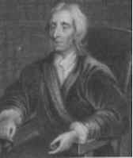
Locke’s Social Contract
Problem: finding an impartial arbitrator— who shall be judge?
You would give up
Your right to execute the law of nature
You gain
Impartial judgment

Slide 8
Natural and social rights
Rights to life, health, liberty, and property are natural— you have them in the state of nature
You do not give them up in the social contract
You can’t give them up they come from nature
Slavery would be wrong even if voluntary

Slide 9
Natural vs. Civil Rights
Locke: “Bottom-up” model
Some rights are natural, independent of government
Government derives its power from the rights individuals allow the government to control

Slide 10
Hobbes VS. Locke
Hobbes | Locke
Leviathan People should be strictly controlled to ensure orderly society Absolute monarchy Against idea of revolutions; people should not be allowed to overthrow government More pessimistic view of nature This was a result of Louis XIV’s rule Collectivism (the government thinks for you) | Two Treatises of Government Natural rights = rights that belonged to all humans from birth Purpose of government: to protect people’s natural rights Government should be limited; accepted by all people; not an absolute monarchy Government has responsibility to people; people can overthrow government if it doesn’t protect people’s natural rights More optimistic view of nature Separation of Church and State Individualism (everyone thinks for himself)

