Slide 1
What do you observe?

Slide 2
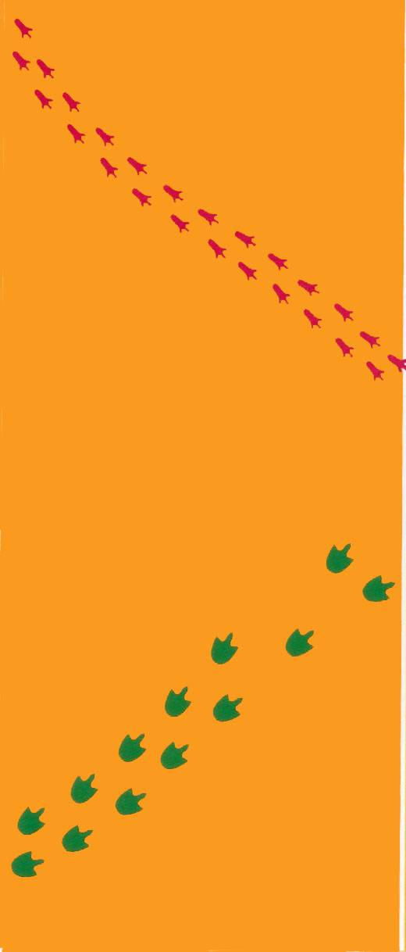
Fossil Footprints
What do you observe?
What do you infer?

Slide 3
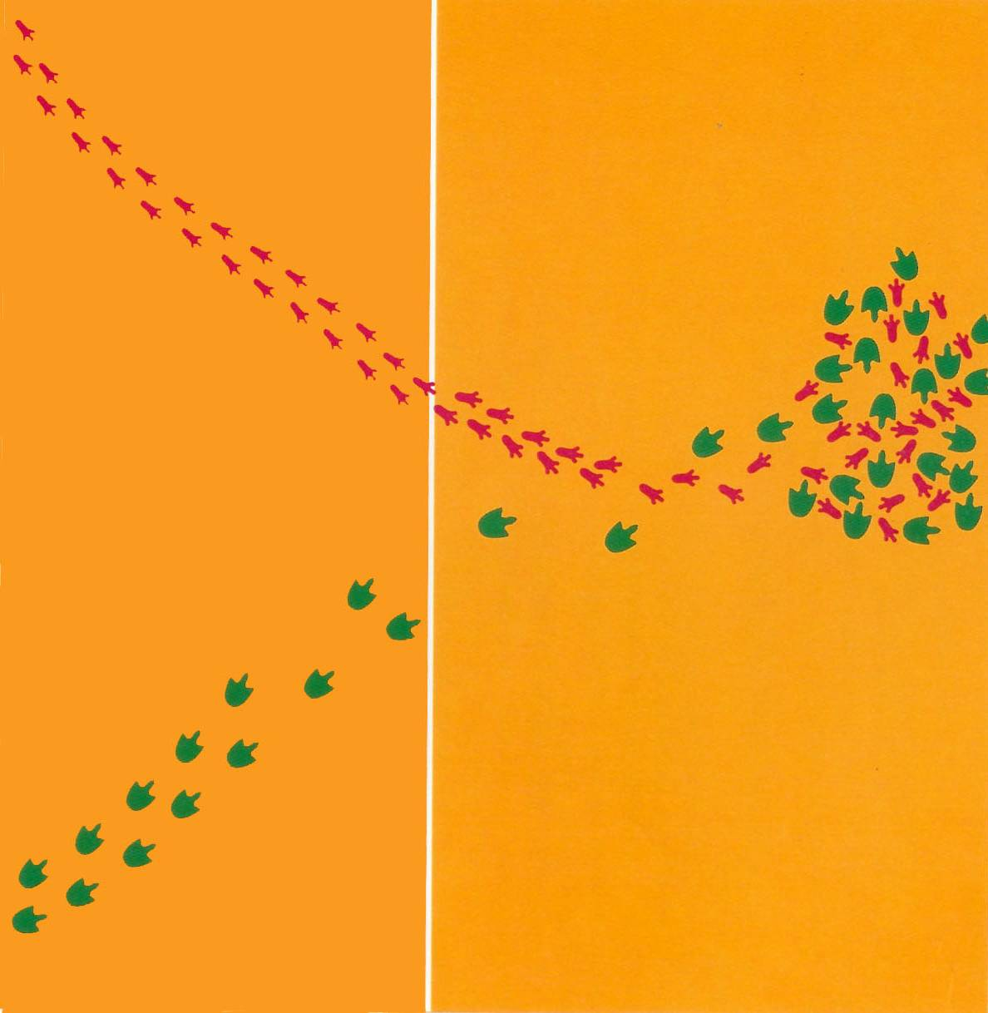

Slide 4
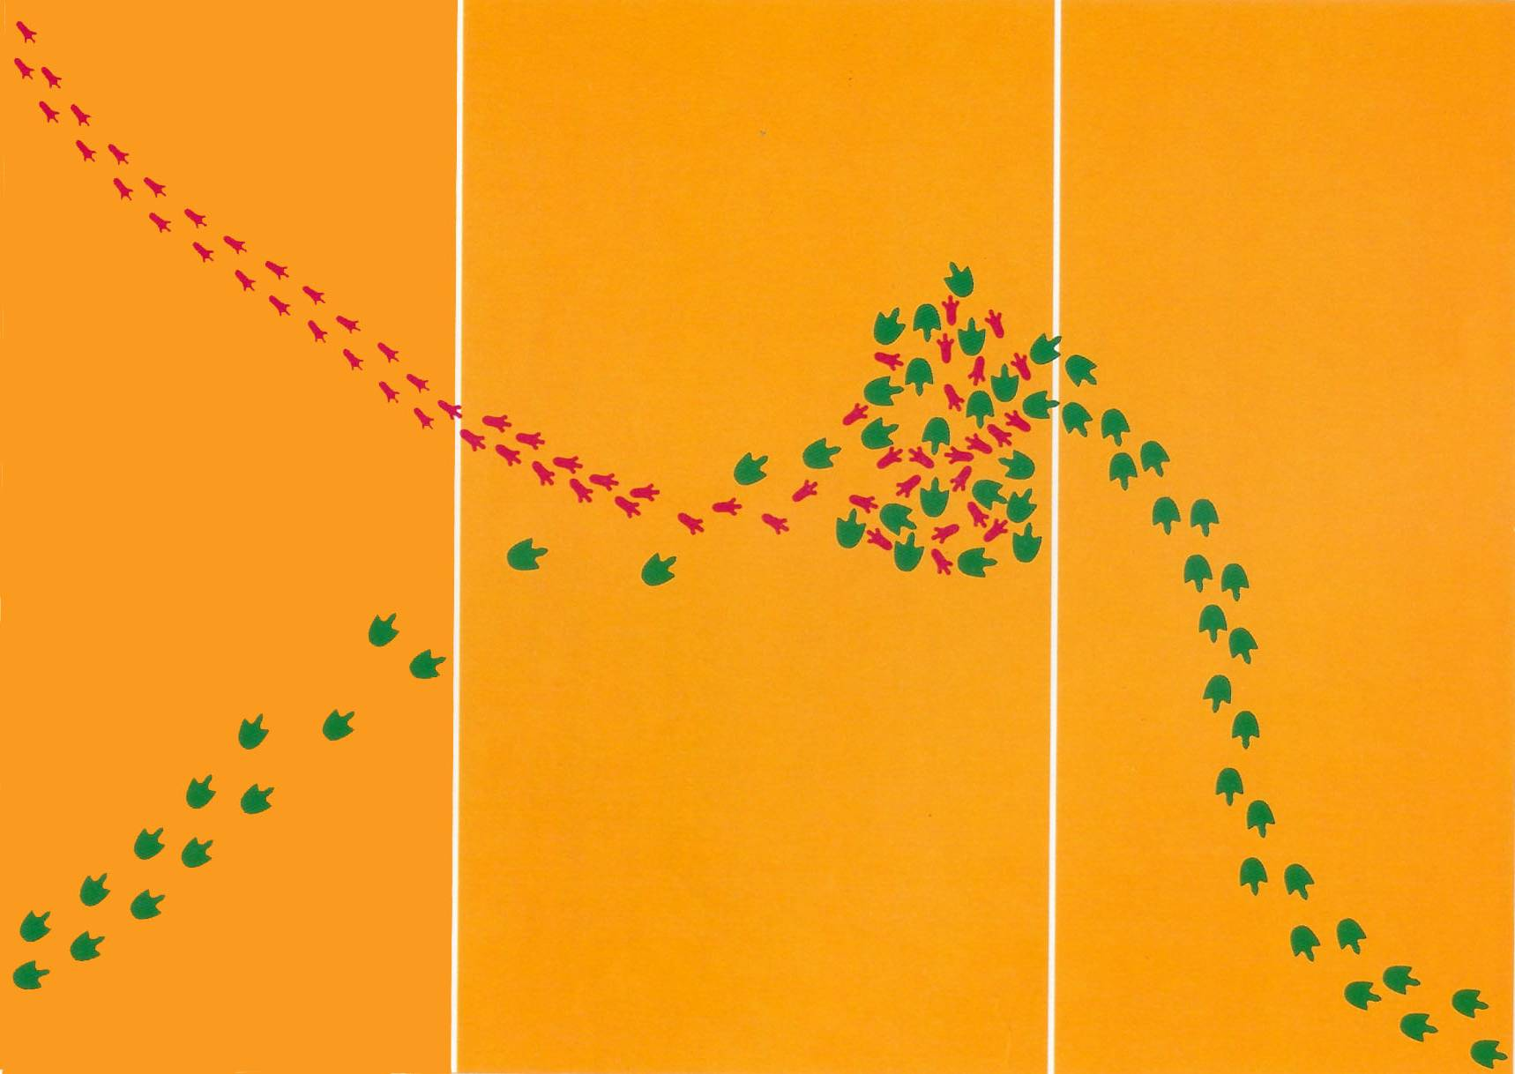

Slide 5
Fossil Footprints
What did you learn from Fossil Footprints?
What is the difference between an observation and an inference?
Can you write a definition for observation and a definition for inference.

Slide 6
Observation
An act of viewing or noting a fact or occurrence for some scientific purpose.

Slide 7
Inference
The process of arriving at some conclusion based on assumed premises.

Slide 8
Observation in Practice
Practice with observation in the scientific process.

