Slide 1
The Scientific Revolution

Slide 2
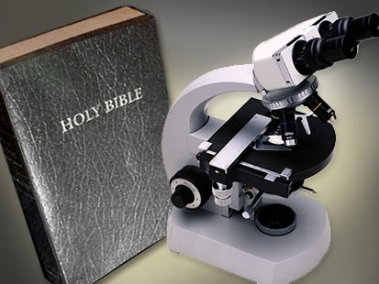
Aim: Why was the Scientific Revolution important to World History and Today?
Do now: What is the difference between religion and science?

Slide 3
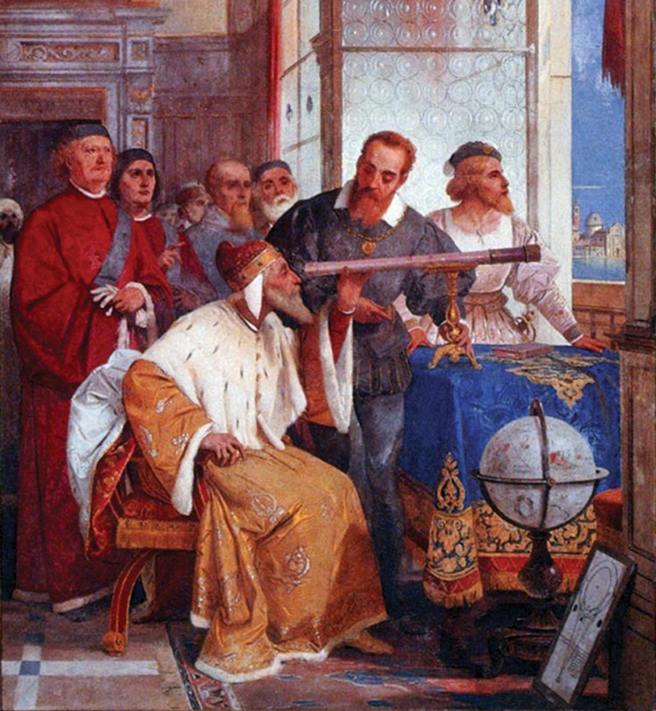
Background
The Scientific Revolution changed the way people thought about the physical world around them.
The Scientists of this time questioned traditional beliefs about the workings of the universe.

Slide 4
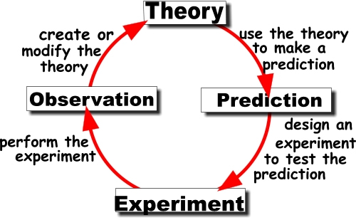
The Scientific Method
The scientific method uses observation and experimentation to explain theories on the workings of the universe.
This process removed blind adherence to tradition from science, and allowed scientists to logically find answers through the use of reason.
The basis for the Scientific Revolution was the Scientific Method.

Slide 5
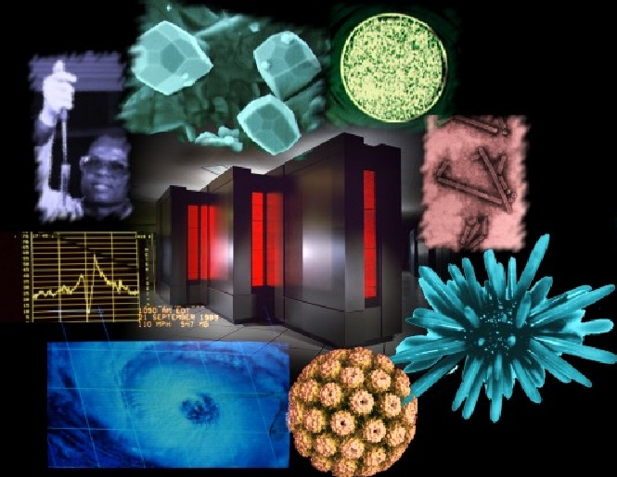
Discoveries & Achievements
The Scientific Revolution was from 1650s to Early 1800s
It involved gradual developments in astronomy, physics, chemistry, and biology.

Slide 6
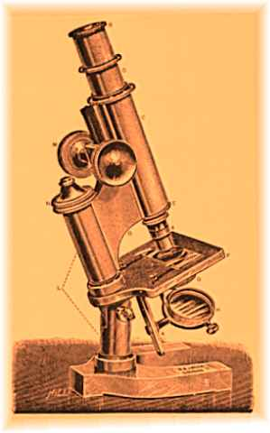
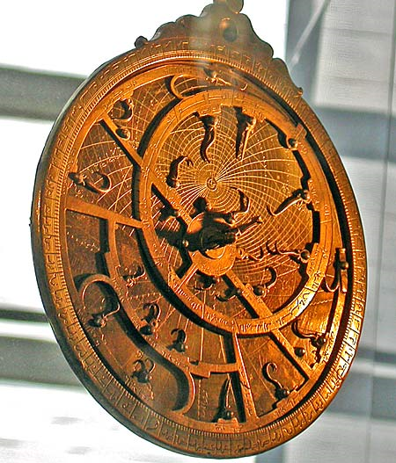
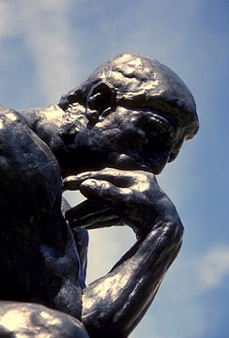
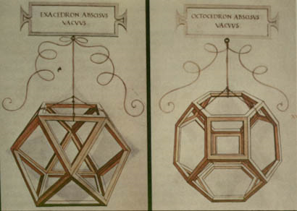
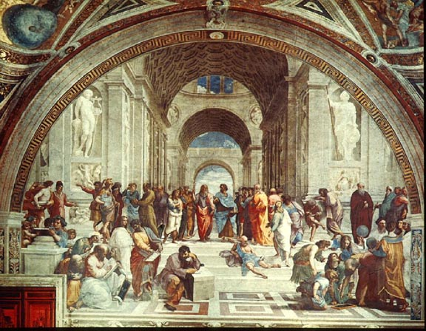
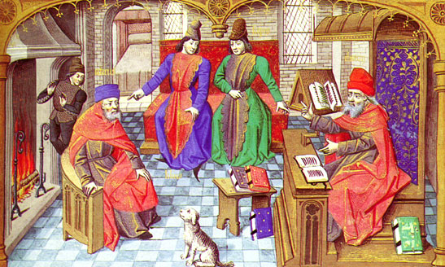
Causes of the Scientific Revolution
Medieval Intellectual Life and Medieval Universities
The Italian Renaissance
Renewed emphasis on mathematics
Renaissance idea of Humanism
Navigational problems of long sea voyages
Better scientific instruments

Slide 7
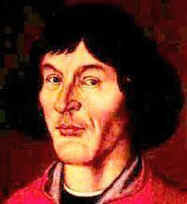
Copernicus (1473-1543)
Aim to glorify God
Sun-centered universe
Challenged circular orbits
Universe of staggering size
Earth no different than any other planet
On the Revolutions of the Heavenly Spheres (1543)
Did not get in trouble by the Roman Catholic Church since his theory was published after his death.

Slide 8
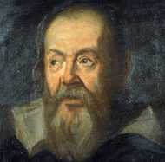
Galileo Galilei (1564-1642)
Used the experimental method
He made discoveries using the telescope
He challenged the church’s categories of “form” and “matter”
End of his life was house arrest for being a heretic

Slide 9
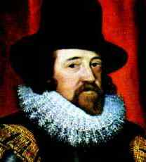
Francis Bacon (1561-1626)
Father of the Scientific Revolution
The Inductive Method (moving from a set of specific facts to a general conclusion)
Emphasis on practical, useful knowledge
New attitude toward nature

Slide 10
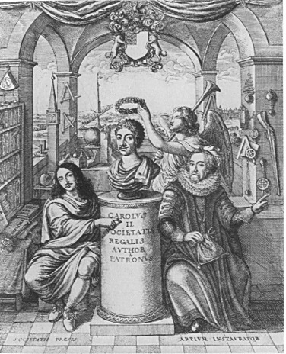
Effects of the Scientific Revolution
Rise of the “Scientific Community”
--Royal Society of London (1662)
--Academy of Royal Sciences (1666)
The modern scientific method
A universe ordered according to natural laws

Slide 11
Effects of the Scientific Revolution
Laws discovered by human reason
“De-Spiritualized” and de-mystified the Universe
Mechanical View of the Universe
Deistic View of God
--God as the cosmic capitalist

Slide 12
Effects of the Scientific Revolution
Skepticism and Independent Reasoning: For example, Descartes reached the extreme of skepticism by doubting his own existence. Then, he realized that his own act of thinking proved his own existence (I think, therefore, I am.)
Challenges to Religion: The idea that the universe worked like a machine according to natural laws and without the intervention of God challenged established religious ideas. This position was adopted by the Deists in the 18th century.
Decline in Belief in Magic, Demons, and Witchcraft: By the 18th century, the educated classes denied the existence of demons and the power of witchcraft. The skeptical views of the educated classes were not shared by the common people for whom religion remained important. The result was a divide between learned and popular culture.
Questions about Humanity's Role in the Universe: By making humans the inhabitants of a tiny planet circling the sun, the Copernican Universe reduced the importance of humanity. It led people to begin to question the place of humanity in creation.
Gave Humanity Control of Nature: Some philosophers argued that by gaining knowledge of the laws of nature, people could control nature. Through science and technology, they could improve human life. This belief in progress became an integral part of Western culture.
Challenges to Established Views of Women: The new scientific ideas challenged the ancient and medieval beliefs about the physical and mental inferiority of women by concluding that both men and women made equal contribution to reproduction. Nevertheless, traditional notions about women continued to dominate

