Slide 1
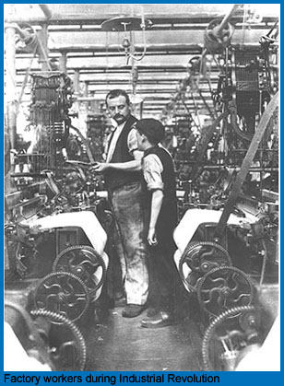
The Industrial Revolution
AIM: What were the causes and effects of the Industrial Revolution?
Do Now: Journal question
Europe c.1740- Early 1900s

Slide 2
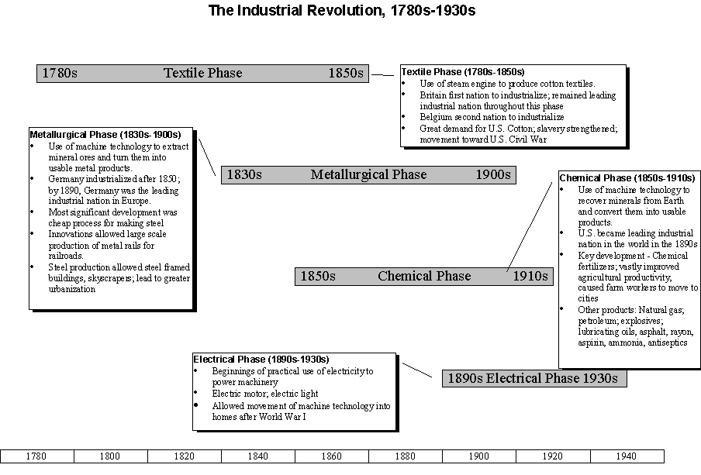
Industrial Revolution

Slide 3
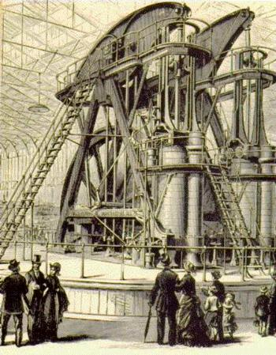
What was the Industrial Revolution?
A shift from home made goods to mass produced factory goods.
Began in Great Britain (England, Wales, Scotland, N. Ireland) in the Middle of the 1700s

Slide 4
Geography:
Great Britain has an abundance of the natural resources needed for industrialization, such as iron ore and coal. Britain also had access to many navigable rivers and natural harbors which provided for the easy movement of goods both within the country, and overseas.
Capital:
The British had a vast overseas empire that provided them with a strong economy. They had the capital (money) needed to build railroads, factories, and mines. They had growing population which resulted in a large work force.
Technology & Energy:
Britain experienced a revolution in energy use as they switched from animal power, to water power, to steam power in a few short years. The steam engine was the power source of the Industrial Revolution.
Why Britian?

Slide 5
Causes of the Industrial Revolution
Agrarian Revolution:
was a change in farming methods that allowed for a greater production of food.
This revolution was fueled by the use of new farming technology such as the seed drill and improved fertilizers.
The results of this revolution in farming was a population explosion due to the higher availability of food.
Also, the Enclosure Movement, which was the consolidation of many small farms into one large farm
Left many people jobless and homeless.
These people would provide the workforce of the Industrial Revolution

Slide 6
Mass Production:
The use of the Factory System
Allowed for mass production of textiles and other goods.
This shifted people from production at home with the Put Out System
This shifted people to production in large factories in cities.
Mass production also allowed for lower prices on the goods produced.
Led to market economy
Effects of the Industrial Revolution

Slide 7
Big Business:
As the Industrial Revolution grew, so did business.
To meet the needs of this growth, business owners sold shares of their companies to stockholders who would share the profits and losses.
The influx of capital allowed business to grow into corporations that had dealings in many different areas.
Laissez-Faire Economics:
Economic philosophy begun by Adam Smith
In his book, Wealth of Nations, he stated that business and the economy would run best with no interference from the government (hands-off).
Dominated most of the Industrial Revolution.
Effects of the Industrial Revolution

Slide 8
New Social Class Structure
Upper Class:
Very rich industrial & business families.
Owners and investors.
Old Noble class.
Upper Middle Class:
Business people
Managers
Professionals such as, lawyers & doctors.
Lower Middle Class:
Other professionals such as, teachers, shop owners, and office workers.
Working Class:
Factory workers and small farmers.
Laborers
Effects of the Industrial Revolution

Slide 9
Urbanization:
People moved to towns and cities to be closer to the factories.
Conditions were very poor during the early part of the Industrial Revolution
Factory workers lived in over crowded buildings
No sewage or sanitation services
Resulted in widespread disease
Working Conditions:
Factory workers worked very long hours, for little pay, under harsh conditions.
Workers included children as young as 8, boys and girls.
Many people were injured or killed due to unsafe working conditions
Effects of the Industrial Revolution

Slide 10
Societal Changes:
New roles were defined for Middle Class men and women.
MC men went to work in business
MC women worked from home and cared for the family.
The higher standard of living for the Middle Class
their children received some form of formal education.
Working Class families faced many hardships due to poor living and working conditions
most WC children never received an education.
Effects of the Industrial Revolution

