Slide 1
Storming of the Bastille
and the Role of Women

Slide 2
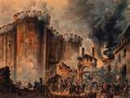
Storming of the Bastille
July 14, 1789
people were angry when King Louis XVI refused to accept the Tennis Court Oath
8,000 Parisian took to the streets of Paris

Slide 3
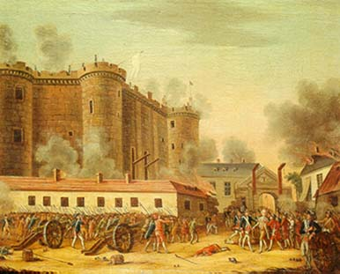
Storming of the Bastille
Bastille was old state prison which also housed ammunition
Guarding troops fired into the crowd killing 98 people
Remaining people stormed the fortress, killing the troops and took remaining ammunition

Slide 4
Why was this event important?
Revolutionaries gained a symbolic victory over the Old Regime
Showed they were a force to be reckoned with
Word of success cause more riots throughout the country
National Guard was formed under the Marquis de Lafayette

Slide 5
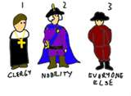
The Destruction of the Old Society
Feudalism
August 4, 1789 National Assembly voted to end the rights of landlords
Financial privileges of both nobles and clergy are taken away
Declaration of the Rights of Man and Citizen
proclaimed freedom and equal rights for every man
access to public office based on talent
ended tax exemptions
promoted freedom of speech and of the press
If you were the king, how would you react to this latest development?

Slide 6
What about the women?
Rights were not extending
Olympe de Gouges
Wrote Declaration of the Rights of Women and the Female Citizen
Wrote many plays and pamphlets but was ignored by National Assembly

Slide 7
October 5, 1789 Paris women march on Versailles
Came to discuss the high price of bread and the starvation because of it
Were armed with everything from broomsticks, lances, pitchforks, swords, pistols, to muskets
Forced the King to accept the new decrees

Slide 8
New Constitution
Completed in 1791
Officially set up a limited monarchy
Legislature consisting of 745 members would make the laws
All male citizens had the same rights but only men over 25 who paid a specific amount in taxes could vote
What did this mean for members of the Third Estate?

Slide 9
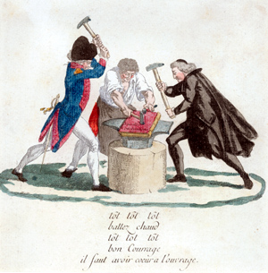
Catholic Church
Church lands were taken away and sold for the debt
Clergy was to be elected by the people and paid by the state

