Slide 1
The Second Stage

Slide 2
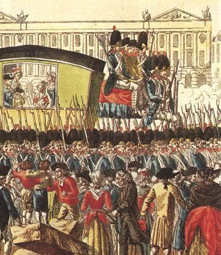
Second Stage Radical Revolution
King Louis asks Austria, Prussia, and Sweden for help in restoring power
Attempts escape to Austria with family; caught and brought back to Paris.
King trusted even less; was abandoning his responsibilities.
Declaration of Pillnitz: warning to France not to harm king and restore him to power or military action taken.

Slide 3
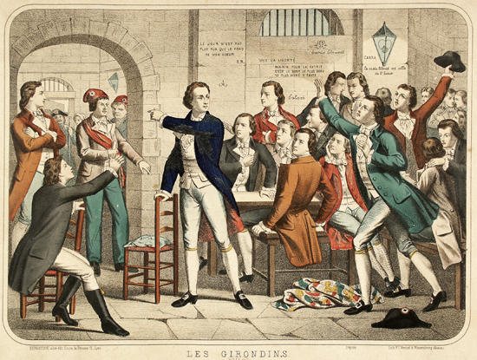
Second Stage Radical Revolution
Divisions formed with the Legislative Assembly: Jacobins and Girondins
Jacobins: radical (against a constitutional monarchy; wanted a republic)
Girondins: moderate (thought a constitutional monarch was necessary)
Sans-culottes: urban
laborers, peasants, and
other French poor; hard
to control; very violent

Slide 4
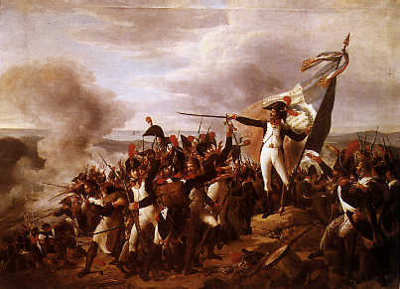
Second Stage Radical Revolution
War against Austria and Prussia
National Assembly felt threatened by Declaration of Pillnitz
Declared war on Austria and Prussia
Austria and Prussia were ready
for them
France lost; couldn’t get
army together
France has no
organized army

Slide 5
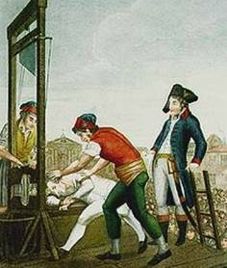
Second Stage Reign of Terror (1793-1794)
Committee for Public Safety
Created to help restore order and protect country from external threats
Headed by Robespierre
Rash of executions ensued
Nothing productive accomplished; focus shifted from equality to peace.
Guillotine
40,000 die
King and Queen Beheaded

Slide 6
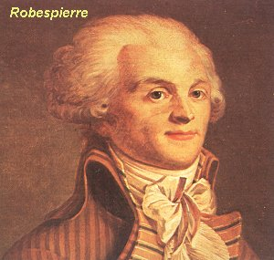
Jacobin’s Coup
Committee of Public safety weak and ineffective
Sans culottes storm National Convention
Girondins accused of representing aristocracy
Robespierre took control of convention; banished Girondins
Results
Robespierre later executed
Girondins come back into power

Slide 7
The Third Stage

Slide 8
Third Stage—Return of the Moderates (1794-1799)
The Directory governed
Directory = 5 officers
No legislative power
Could appoint people to governmental offices
Upper House =250 members
Lower House = 500 members
Some military successes (Napoleon)
Directory criticized for poor leadership
Napoleon overthrows Directory; ends French Revolution

Slide 9
The Rise of Napoleon

Slide 10
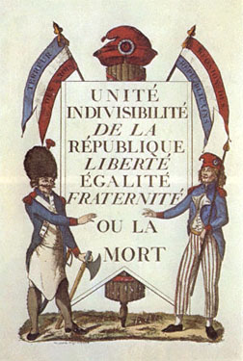
French Revolution
Watch the video.
Write down at least 5 important details mentioned about the French Revolution. -Be sure to include at least one fact from each stage of the French Revolution.
After the video:
How did the stages of the French Revolution differ and which group benefited the most?

