Slide 1
The First Stage

Slide 2
First Stage (1789-1793)
King Louis XVI desired raising new taxes
to stabilize economy
King called the Estates General
3 estates = 3 Classes
Made up of members from the Three Estates
Each estate had one vote
Not met for 150 years
Needed to meet
Certified by Parliament
(high court)
Election in early 1789

Slide 3
The Estates-General Meets
The matter at hand was taxes
The King intended for the Third Estate to be there as a Symbol,
no power
The Third Estate wanted to meet as one body, and 1 vote per person
Finally met in Spring 1789
1st & 2nd Estate voted against 3rd Estate
2 to 1 vote
3rd Estate walked out
Not being allowed to air their grievances, the Third Estate moved to the Tennis Court
now the National Assembly

Slide 4
National Assembly (1789-1793)
3rd estate met in indoor tennis court
Resolved to stay in session until constitution could be written
King couldn't get money
King instructed 1st and 2nd estates to meet with National Assembly
3rd estate doubled their numbers
1st and 2nd sat on right, 3rd sat on left
Formed municipal (city) government

Slide 5
National Assembly (1789-1793)
Locked out of the Estates-General, the National Assembly signed the Tennis Court Oath
They agreed not to separate till there was a new constitution for France
The King supported both sides at the same time
The Estates-General no longer exist, as of 9, July 1789
National Assembly consists of
all equal men

Slide 6
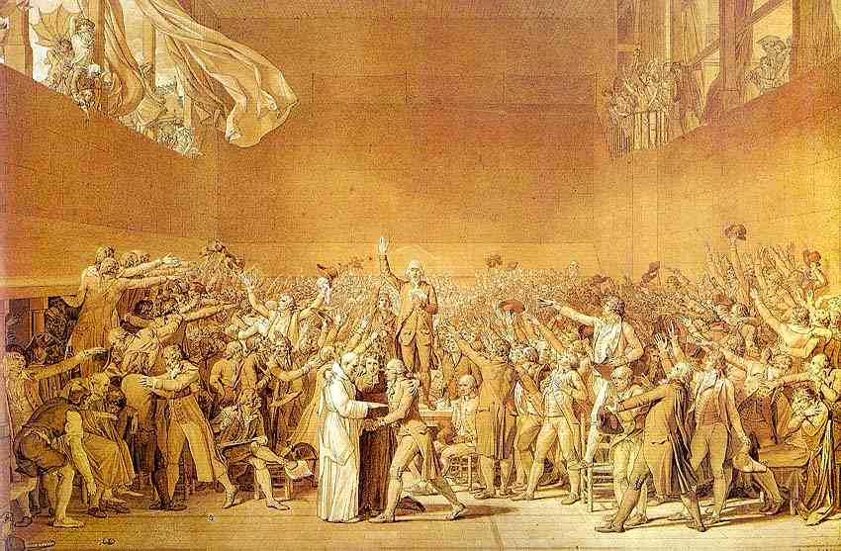

Slide 7
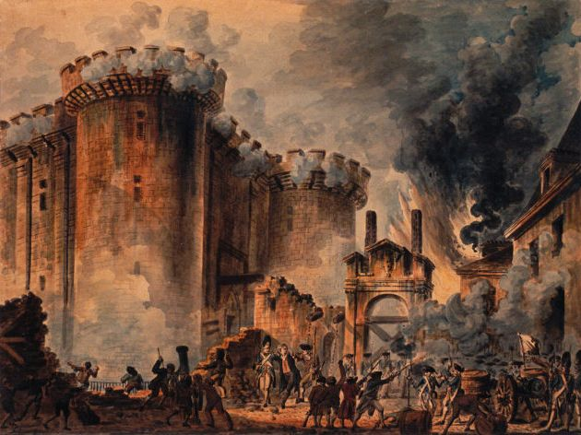
Fall of the Bastille
Events at Bastille Prison
July 14, 1789
Municipal government trying to get arms
Revolts in the countryside

Slide 8
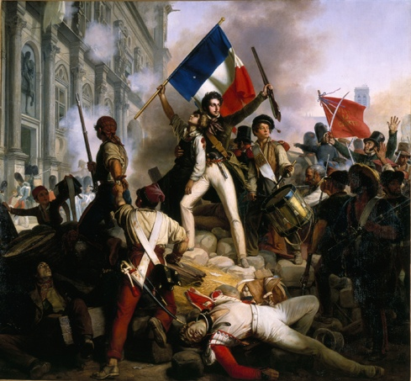
Origins of the French Revolution
Take notes on the video. Write five (5) important details from the video about the French Revolution

Slide 9
The French Revolution from the Video

Slide 10
Actions of the National Assembly
Destruction of privilege (nobility)
Declaration of the Rights of Man
1. Men are born and remain free and equal in rights. Social distinctions may be founded only upon the general good.
2. The aim of all political association is the preservation of the natural and imprescriptible rights of man. These rights are liberty, property, security, and resistance to oppression.
3. The principle of all sovereignty resides essentially in the nation. Nobody nor individual may exercise any authority which does not proceed directly from the nation.
4. Liberty consists in the freedom to do everything which injures no one else; hence the exercise of the natural rights of each man has no limits except those which assure to the other members of the society the enjoyment of the same rights. These limits can only be determined by law.
5. Law can only prohibit such actions as are hurtful to society. Nothing may be prevented which is not forbidden by law, and no one may be forced to do anything not provided for by law.
6. Law is the expression of the general will. Every citizen has a right to participate personally, or through his representative, in its formation. It must be the same for all, whether it protects or punishes. All citizens, being equal in the eyes of the law, are equally eligible to all dignities and to all public positions and occupations, according to their abilities, and without distinction except that of their virtues and talents.
7. No person shall be accused, arrested, or imprisoned except in the cases and according to the forms prescribed by law. Any one soliciting, transmitting, executing, or causing to be executed, any arbitrary order, shall be punished. But any citizen summoned or arrested in virtue of the law shall submit without delay, as resistance constitutes an offense.
8. The law shall provide for such punishments only as are strictly and obviously necessary....
9. As all persons are held innocent until they shall have been declared guilty, if arrest shall be deemed indispensable, all harshness not essential to the securing of the prisoner's person shall be severely repressed by law.
10. No one shall be disquieted on account of his opinions, including his religious views, provided their manifestation does not disturb the public order established by law.
11. The free communication of ideas and opinions is one of the most precious of the rights of man. Every citizen may, accordingly, speak, write, and print with freedom, but shall be responsible for such abuses of this freedom as shall be defined by law.
12. The security of the rights of man and of the citizen requires public military forces. These forces are, therefore, established for the good of all and not for the personal advantage of those to whom they shall be instructed.
13. A common contribution is essential for the maintenance of the public forces and for the cost of administration. This should be equitably distributed among all the citizens in proportion to their means.
14. All the citizens have a right to decide, either personally or by their representatives, as to the necessity of the public contribution; to grant this freely; to know to what uses it is put: and to fix the proportion, the mode of assessment and of collection and the duration of the taxes.
15. Society has the right to require of every public agent an account of his administration.
16. A society in which the observance of the law is not assured, nor the separation of powers defined, has no constitution at all.
17. Since property is an inviolable and sacred right, no one shall be deprived thereof except where public necessity, legally determined, shall clearly demand it, and then only on condition that the owner shall have been previously and equitably indemnified.
Secularization of the church
New Constitution

