Slide 1
Age of Exploration
Today I will learn why explorers investigated new land
Today my job is to complete the explorers worksheet

Slide 2
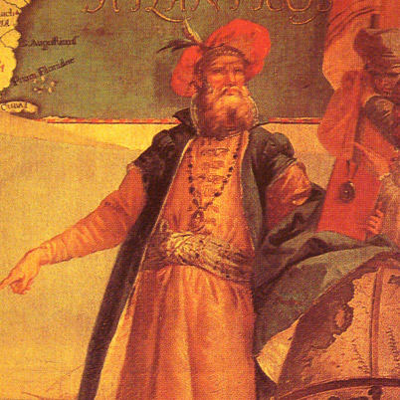
John Cabot
Born in Italy (Giovanni Caboto)
Sailed for England 1497-1498
Wanted to find a route to Asia
Claimed land for England

Slide 3
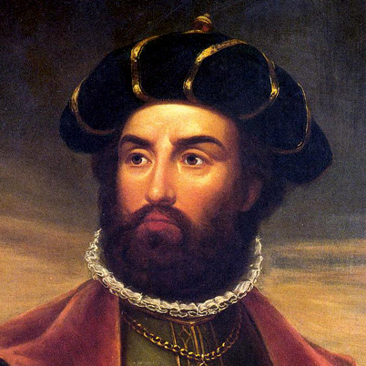
Vasco De Gama
Born in Portugal
Sailed for Portugal from 1497-1503
Found the first all water route to Asia
He established trade and on subsequent trips slaughtered many Muslims

Slide 4
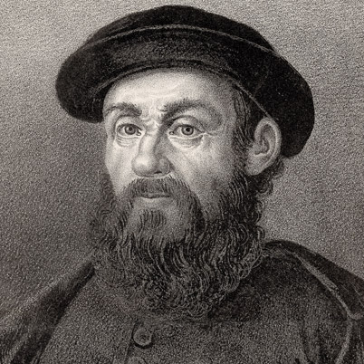
Ferdinand Magellan
Born in Portugal
Sailed for Spain 1519-1521
He wanted to circumnavigate the world
He died while fighting Natives in the Philippines
His ship made it back to Spain the next year

Slide 5
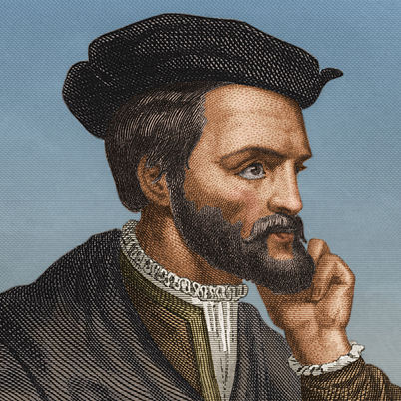
Jacques Cartier
Born in France
Sailed for King Francis the I of France from 1534-1541
He was looking for gold, other riches, spices and a faster route to Asia
Tried to establish a settlement. He abandoned it and returned to France.

Slide 6
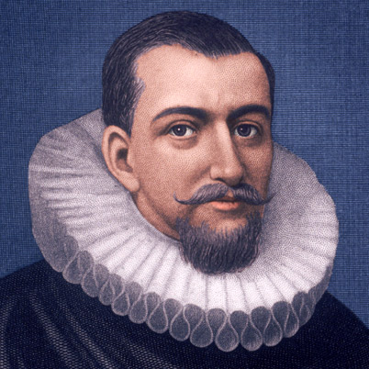
Henry Hudson
Born in England
Sailed for England and the East India Company
Searched for an ice-free passage to Asia
Voyages searching for Asia from 1607-1611
Hudson traded and fought with natives

Slide 7
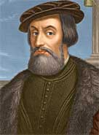
Hernando Cortes
Born in Spain
Explored for Spain 1519-1541, wanted to find a straight to the ocean
Defeated the Aztec Empire in present day Mexico

Slide 8
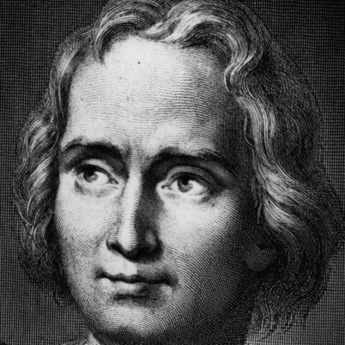
Christopher Columbus
Born in Italy
Sailed for Spain from 1492-1504
Looking for a waterway to Asia
Established colonies in the West Indies

Slide 9
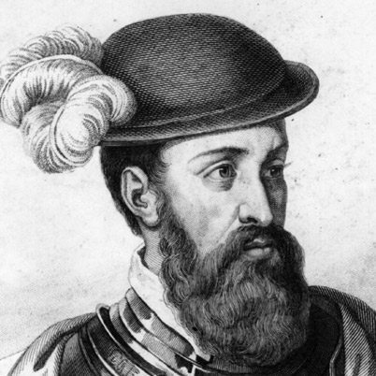
Francisco Pizarro
Born in Spain
Conquistador for Spain from 1526-1541
Defeated the Inca Empire who controlled present day Peru, Ecuador and Chile
Gained control through violence

Slide 10
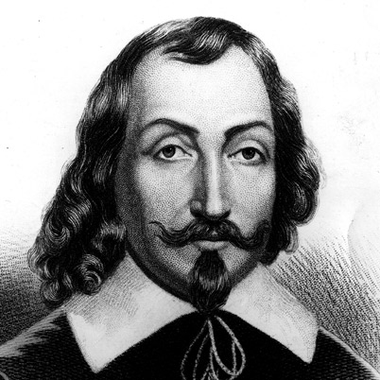
Samuel de Champlain
Born in France
Sailed and governed for France 1601-1635
He explored Canada and helped establish Quebec as a city and trading post

