Slide 1
The Enlightenment
AIM: What was the Enlightenment?
Do Now: What era/revolution led to the Enlightenment?
Mr. Ott - Global History & Geography @ BETA

Slide 2
What do you think the word Enlightenment means?
The belief that man could use logic and reason to solve the social problems of the day.

Slide 3
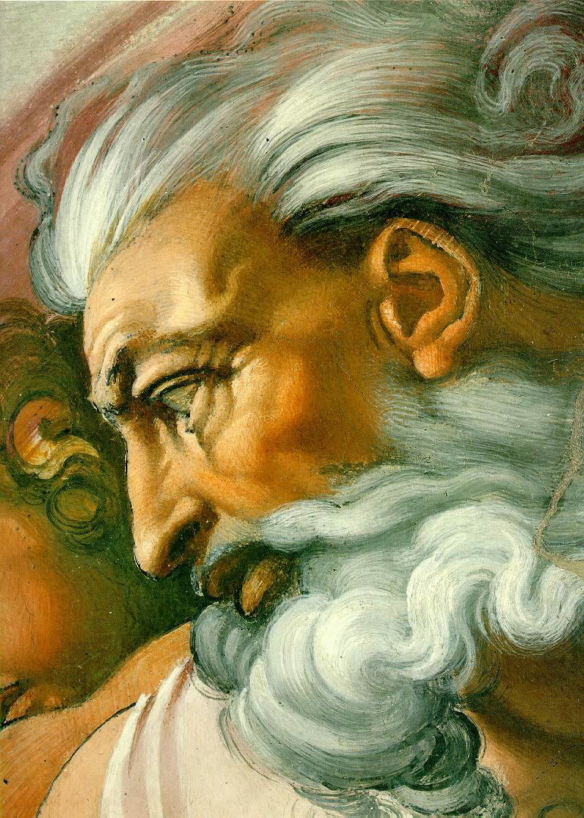
Before the Enlightenment…
Until then, most people believed that god controlled the universe.
What made people start to think differently?
Renaissance
Humanism
Scientific Revolution

Slide 4
Enlightenment thinkers
Queen Elizabeth I
Thomas Hobbes
John Locke
King Louis XIV
Baron de Montesquieu
Jean Jacque Rousseau
Adam Smith
Denis Diderot

Slide 5
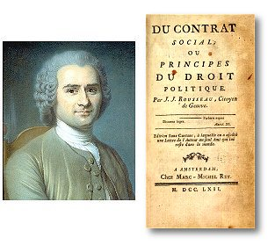
The Social Contract (1651)
During the scientific revolution the social contract was invented by Jean Jacques Rousseau. The idea behind the contract was that a ruler would have absolute power given to him by the people who were under absolute control.
Rousseau was a believer in Absolute Monarchy.
Jean Jacques Rousseau

Slide 6
Jean-Jacques Rousseau
“Top-down” model
All rights are civil, dependent on government
Rights of individuals come from government, not from nature or God

Slide 7
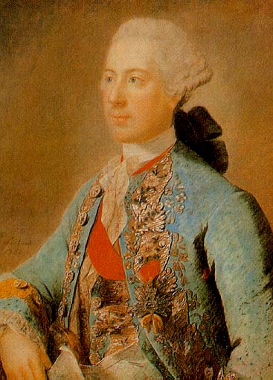
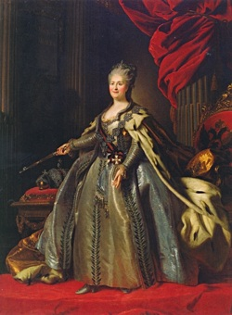
Enlightened Despot (1700)
The philosophers tried to convince monarchs to rule justly.
Some monarchs embraced the new ideas and made reforms that reflected the Enlightenment spirit.
They became known as Enlightened Despots. (Despot means absolute ruler)
The enlightened depots supported the philosophers ideas. But they also had no intention of giving up any power.
The foremost of Europe's’ enlightened despots were Frederick II of Prussia and Catherine the Great of Russia.
Notes:
In the 1700s, Paris was the cultural and intellectual capital of Europe.
Young people from around Europe-and also from the Americas-came to study, philosophize, and enjoy fine culture.
The brightest minds of the age gathered there. From their circles radiated the ideas of the Enlightenment.
…the Enlightenment spirit also swept through Europe’s royal courts.
Many philosophers believed that the best type of government was a monarchy in which the ruler respected the people’s rights.

