Slide 1
Doing Science
Design an Experiment
example

Slide 2
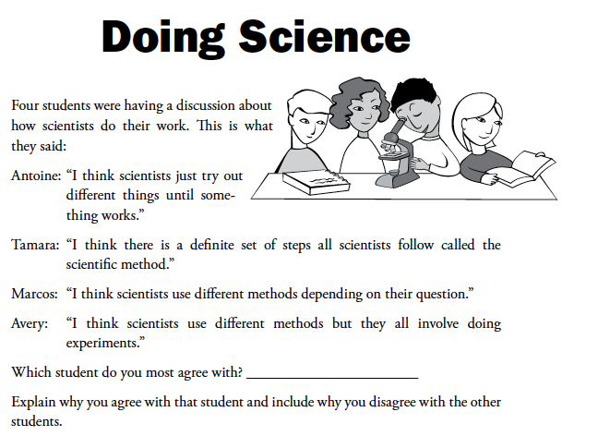

Slide 3
Inquiry Study/Investigation
List some of the ways scientists study or investigate the natural world and give an example of each.

Slide 4
Investigations
Remote observations
Field studies
Collections
Systematic observations
Modeling (physical, mathematical, computer simulations)
Literature studies
Experiments

Slide 5
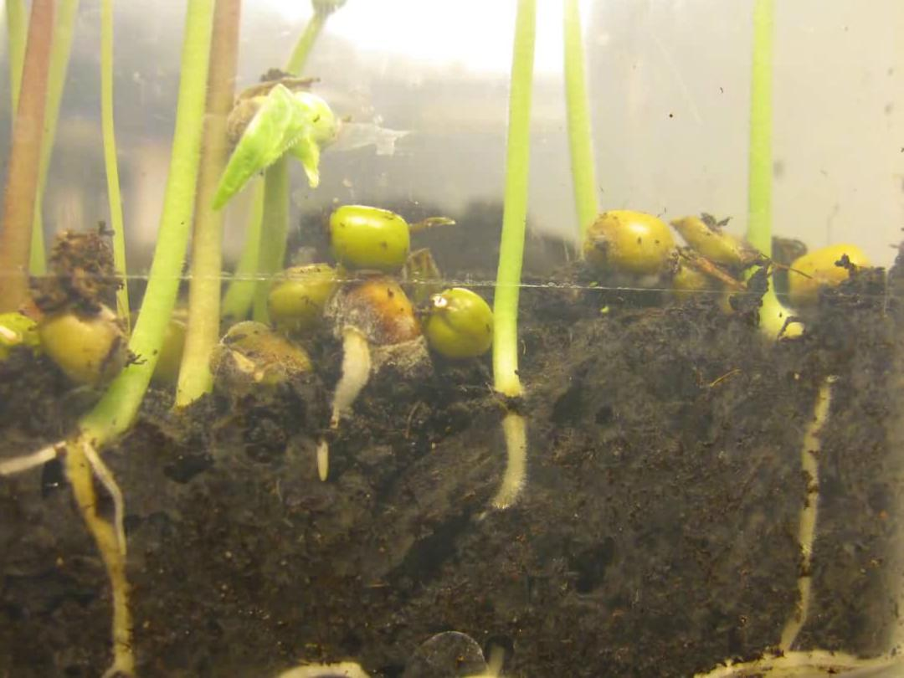
Seed Germination
What factors affect seed germination?
Notes:
5

Slide 6
Brainstorming Ideas Related to My Initial Question
Things I could change or vary when I `germinate my seeds:
  Type of seeds
  Amount of water
  Soil
  Amount of light
  Time to sprout
Notes:
6

Slide 7
Things I could change
Amount of
water
Type of
seeds
Temperature
Type of soil

Slide 8
Things I could measure or observe
Length of sprouts
Time it takes to sprout
Color of sprouts
Number of seeds sprouted

Slide 9
Identifying Variables Related to My Initial Question
I will change the amount of water
I will observe number of seeds sprouted
I will not change the type of seed, the temperature, type of soil
I will not measure the length of the sprouts, time it takes to sprout, color of the sprouts
Notes:
9

Slide 10
Formulating a Testable Question
When I change:
the amount of water,
What happens to:
the number of seeds that sprouted?
Guiding Question: How does the amount of water affect the number of seeds that germinate?
Notes:
10

Slide 11
Hypothesis versus Prediction
When would students make a hypothesis?
When would they make a prediction?
Are there times when they would do neither?
What is the difference between a hypothesis and prediction?
At what grade level does the word “hypothesis” appear in the standards?
Notes:
11

Slide 12
Developing the Procedure
Materials:
What I will change (independent or manipulated variable):
How I will carry out the change:
Number of samples:
The data I will collect (dependent or responding variable):
How I will collect the data:
How I will record the data:
Notes:
12

Slide 13
The Swinging Pendulum
Design an Experiment

Slide 14
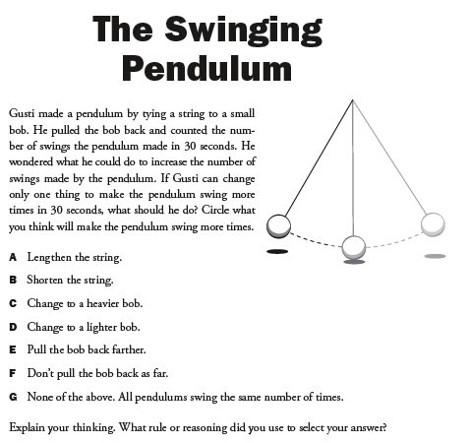

Slide 15
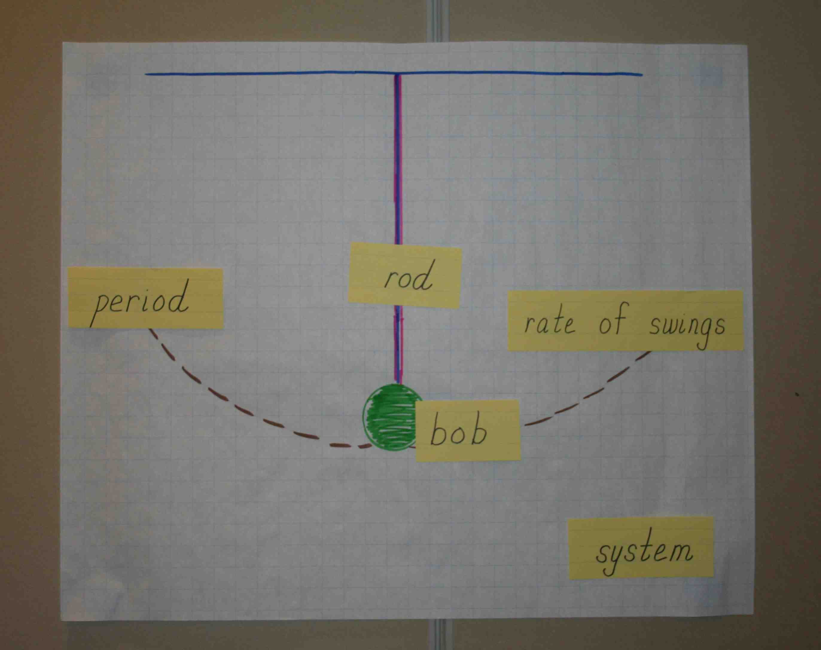

Slide 16
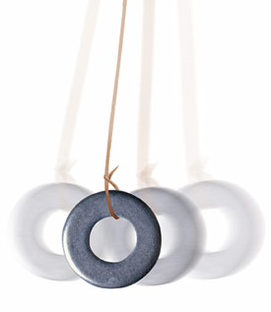
Part 1- DESIGNING THE EXPERIMENT
What are you wondering about?

Slide 17
Things We Can Change
Length of pendulum
Mass of the bob
Release point of the pendulum
Shape of the bob

Slide 18
Things we can measure
Period of the pendulum (time it takes to make one full swing)
Number of complete swings in a given time period (30 sec)
How long it takes the pendulum to come to rest
Number of swings before pendulum comes to rest

Slide 19
3 Experiment Groups
Length
Mass of bob
Angle of release
Stop at C-E-R !

Slide 20
Claims-Evidence-Reasoning
(C-E-R)Framework
Claim- Statement that answers the question.
Evidence- Scientific data that support the claim.
Reasoning- Justification that connects the evidence to the claim, using a scientific principle when appropriate, or showing how other data do not support the claim.

Slide 21
Pendulum Explanation
Use the C-E-R Framework to write a scientific explanation about what affects the swing of a pendulum.
Claim
Evidence
Reasoning

Slide 22
Look Back and Reflection
I used to think _________ but now I know _________________________
Notes:
22

Slide 23
The Crooked Swing
Applying: from experimentation to engineering

Slide 24
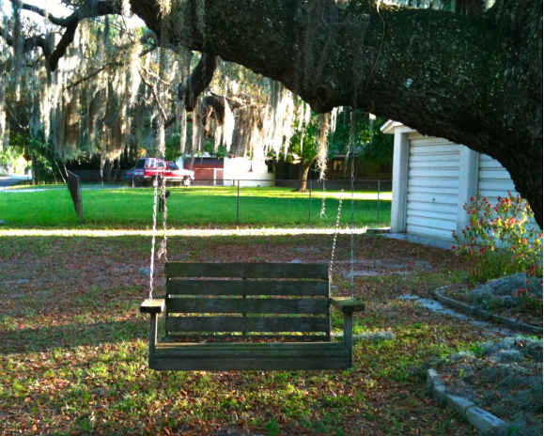
The Crooked Swing
THE CROOKED SWING

Slide 25
Engineering Design Process
Identify the problem
Use scientific knowledge to define the problem
Brainstorm possible solutions
Identify constraints
Select best possible solution
Construct a model
Test and evaluate model
Refine the design
Communicate solution

Slide 26
Claims-Evidence-Reasoning
(C-E-R)Framework
Claim- Statement that answers the question.
Evidence- Scientific data that support the claim.
Reasoning- Justification that connects the evidence to the claim, using a scientific principle when appropriate, or showing how other data do not support the claim.

Slide 27
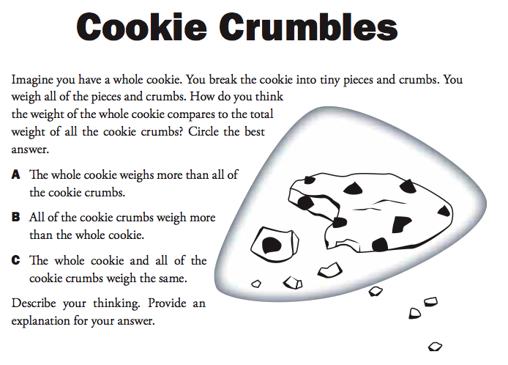

Slide 28
P-E-O
Predict (commit to an outcome)
Explain (explain your thinking)
Observe (test your prediction and observe results)
If observations don’t match the prediction:
Construct new explanation

