Slide 1
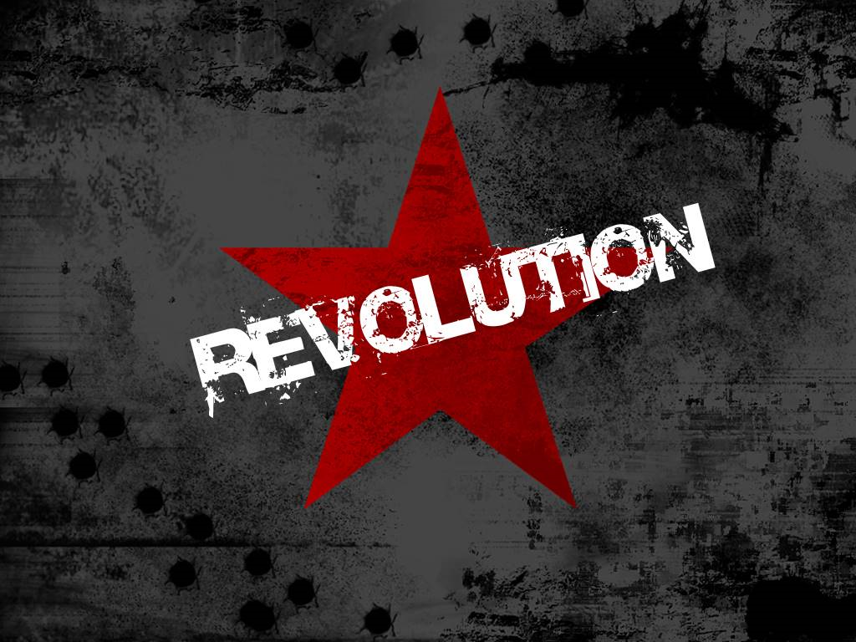
What is it? Why does it happen? Who does it involve? Does it still exist?

Slide 2
Song Analysis Questions
What do these songs have to say about the causes of revolutions? List at least three causes.
Do the artists all have the same opinion on whether revolutions are a good thing? Explain your answer.
What are some of the emotions that go along with revolutionary ideas? List at least three.

Slide 3
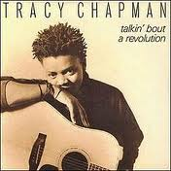
Songs About Revolution
*Click on picture to hyperlink to video.

Slide 4
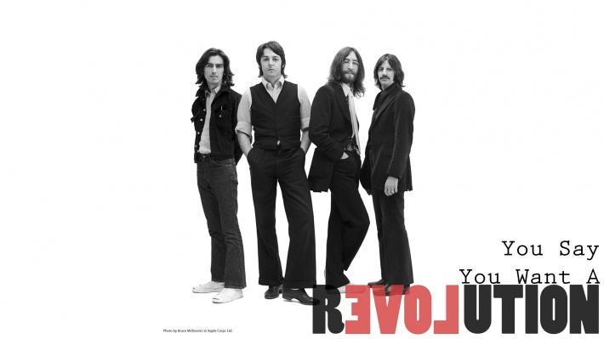
Songs About Revolution
*Click on picture to hyperlink to video.

Slide 5
Songs About Revolution
*Click on picture to hyperlink to video.

Slide 6
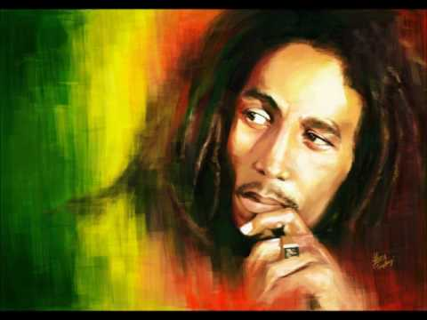
Songs About Revolution
Bob Marley
Burnin’ and Lootin’
*Click on picture to hyperlink to video.

Slide 7
Quotes on Revolution
“A revolution is a force against which no power, divine or human, can prevail…A revolution cannot be crushed, cannot be deceived, cannot be perverted, all the more cannot be conquered…”
PIERRE JOSEPH PROUDHON
“A revolution is not a dinner party, or writing an essay, or painting a picture, or doing an embroidery; it cannot be so refined, so leisurely and gentle, so temperate, kind, courteous, or restrained. A revolution is an insurrection, an act of violence…”
MAO TSE-TUNG, THE CHINESE REVOLUTIONARY LEADER,
MARCH 1927
“Revolutions are never waged singing ‘We Shall Overcome.’ Revolutions are based upon bloodshed.” MALCOLM X, 1964

Slide 8
Quotes on Revolution
“Inferiors revolt in order that they may be equal and equals that they may be superior. Such is the state of mind which creates revolutions.”
ARISTOTLE, 4TH CENTURY BC
“Power is not a means, it is an end. One does not establish a dictatorship in order to safeguard a revolution; one makes the revolution in order to establish the dictatorship.”
GEORGE ORWELL, 1949

Slide 9
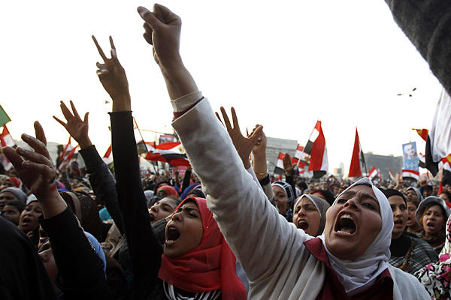
Quotes on Revolution
What are some of the things that happen during revolutions, according to these quotes?
Do these quotes all say the same thing about revolution? Explain your answer with at least five sentences.

Slide 10
A dramatic and wide-reaching change in the way something works or is organized or in people's ideas about it. (Usually non-violent)
What is a Revolution?
Revolutions
A forcible overthrow of a government or social order in favor of a new system (usually violent)
Scientific Revolution
American Revolution
Industrial Revolution
French Revolution
Glorious Revolution

Slide 11
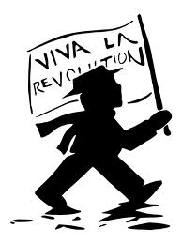
History & Characteristics of Revolutions
Violence is a common feature - usually the execution of rulers
Preceded by a strong belief. There must be a central idea for change before a revolution can occur.
Happens in steps/phases.
Replaces an old order with a new structure.
Ruler refuses to compromise.

Slide 12
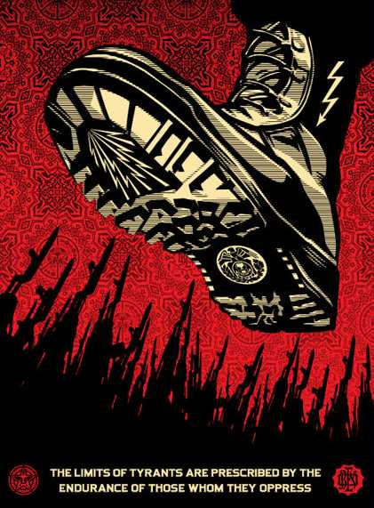
Causes of Revolutions
Material conditions- taxation, drought, famine, economic downturns
Oppression or dire poverty.
Foreign rule - wars of independence
Domino Effect - French soldiers who had fought on the American side in the War of Independence (1775-1783) often returned to France imbued with new ideas of Liberty – French Revolution 1789.

Slide 13
Journal
What would have to happen to make me take up arms and participate in the overthrow of my government?
*One paragraph minimum.

