Slide 1
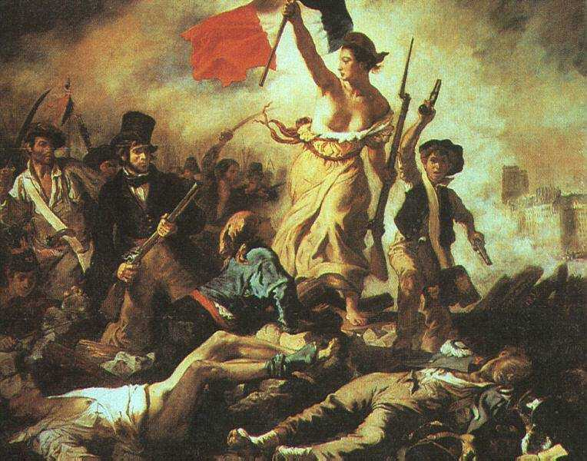
French Revolution
AIM: What were the causes of the French Revolution?
"Liberty Leading the People“
(Eugene Delacroix, 1830).

Slide 2
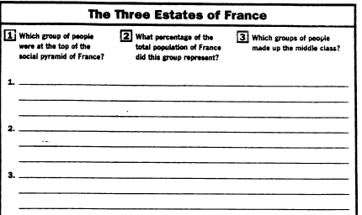

Slide 3
Is a revolution always violent?

Slide 4
Revolution
A dramatic and wide-reaching change in the way something works or is organized or in people's ideas about it. (Usually non-violent)
Scientific Revolution
Commercial Revolution
Industrial Revolution
Information Revolution
A forcible overthrow of a government or social order in favor of a new system (usually violent)
American Revolution
French Revolution
Russian Revolution

Slide 5
Causes and Attitudes
The Enlightenment & The American Revolution
Economic problems
Wars
Royal spending
Poor harvests
The French system’s lack of change
Louis XVI clung to Absolutism
King’s response to the poor
Class resentment
Three Estates

Slide 6
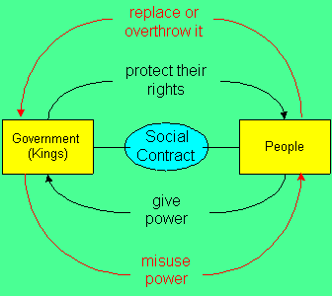
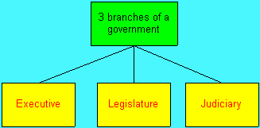
Enlightenment Philosophies
Montesquieu- separation of powers
Rousseau- social contract
Monarchical system vs. aristocracy and bourgeoisie political thought

Slide 7
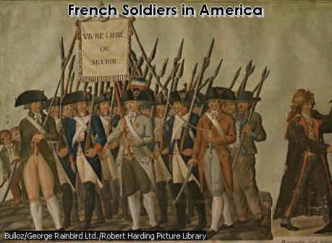
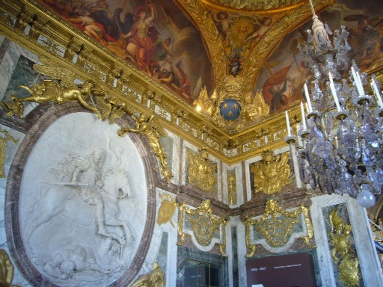
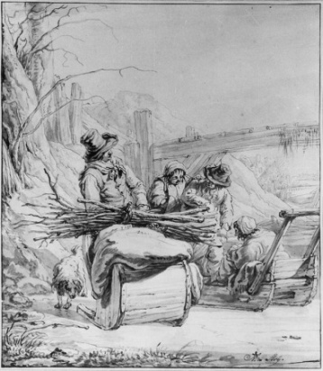
Economic Problems
Poor harvests
1787 and 1788
Food shortages
Price increases
Unemployment
One-third of nation at poverty level
War-
American Revolution
Taxation to aid colonists
Royal spending
Palace luxuries

Slide 8
Unequal Social Stratification- The Three Estates
First Estate- Clergy
Made up about 130,000 people and owned 10% of the land.
Were exempt from taxation. Radically divided.
The Second Estate- Nobility
Consisted of about 350,000 people and owned 25-30% of the land.
Held many leading positions in society (government, military, law, etc.)
Also exempt from taxation but wanted more control.
Third Estate- Commoners
Very divided by occupation, level of education, and wealth.
Peasants- 75-80% of the population
Over half the peasants had little or no land
“Relics of feudalism”
Wage earners- craftspeople, shopkeepers, etc.
Urban population
Rise in consumer prices, stagnant wages
Bourgeoisie- Middle class
Consisted of 2.3 million people and owned 20-25% of the land
Could move into noble class
Owned about 65% of the land
Sole payers of the taille, or chief tax

